Slide 1

CAMBIO CLIMATICO GLOBAL
javiernori@gmail.com

Slide 2
EL CLIMA
El clima son las condiciones atmosféricas a largo plazo se describe a partir de de promedios, extremos y variaciones espaciales y temporales de
Frio y calor
Nubosidad
Humedad
Precipitaciones
Nevadas
ETC
El cambio climático se refiere a la alteración de estos patrones
La termperatura media global es solo una medida del de resumen de las condiciones climáticas.
Pequeños cambios en la T→ grandes cambios en los patrones

Slide 3
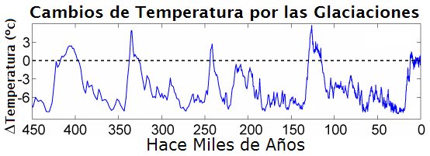
EL CLIMA
El clima cambia de forma natural: por ejemplo, al término de la última glaciación (hace 11 500 años), la temperatura planetaria era 5/6 °C más baja que ahora.
PERO ahora se están produciendo aumentos de temperatura a una velocidad sin precedentes.
Los científicos piensan que la actividad humana es responsable de ello.

Slide 4
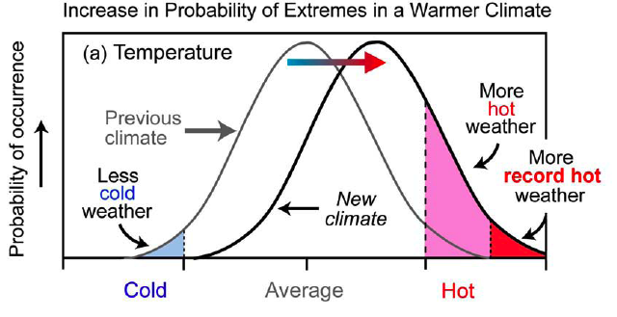
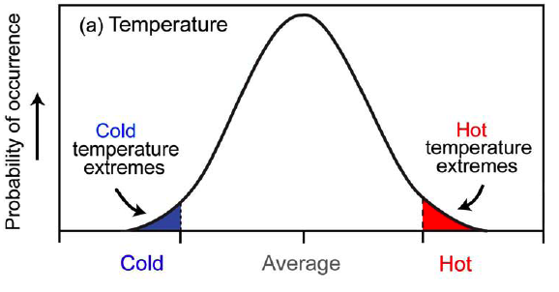
EL CLIMA
EVENTOS EXTREMOS
Lo que considerábamos extremo se hace más frecuente

Slide 5
Qué está pasando?

Slide 6
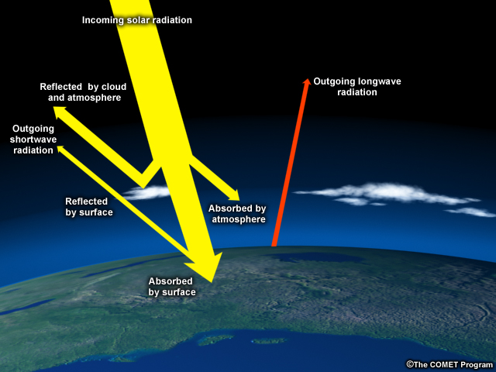
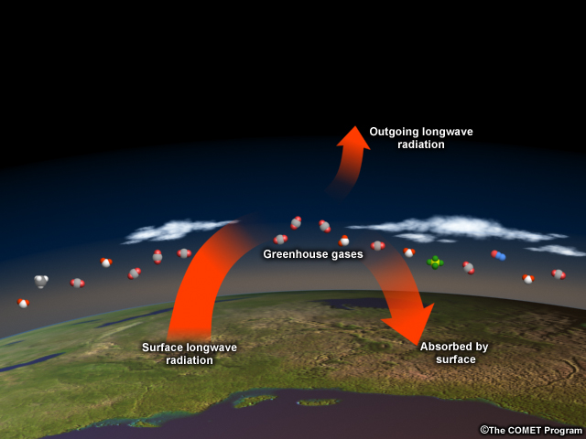
“Greenhouse effect”
Increasing greenhouse gases trap more heat
Notes:
[Image 1] Earth’s surface absorbs heat from the sun and then re-radiates it back into the atmosphere and to space.
[click, Image 2] Much of this heat is absorbed by greenhouse gases, which then send the heat back to the surface, to other greenhouse gas molecules, or out to space. Though only 1% of atmospheric gases are greenhouse gases, they are extremely powerful heat trappers. By burning fossil fuels faster and faster, humans are effectively piling on more blankets, heating the planet so much and so quickly that it’s hard for Mother Nature and human societies to adapt.

Slide 7





Greenhouse gases
Carbon dioxide
Nitrous oxide
Methane
Sulfur hexafluoride
Water
Notes:
While there are many substances that act as greenhouse gases, two of the most important are water and carbon dioxide, or CO2.

Slide 8
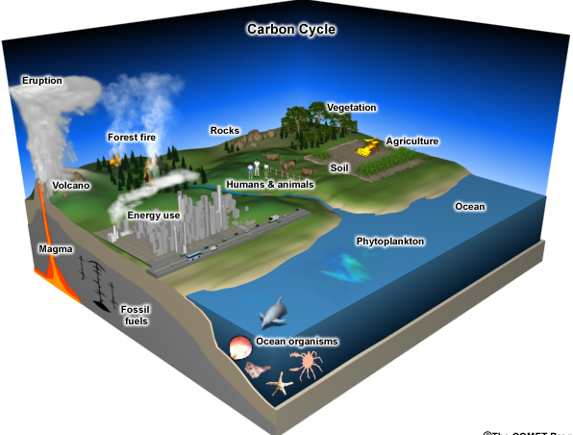
Notes:
[Image 1] CO2 comes from a variety of sources. For example, plants take up carbon dioxide in the air to make wood, stems, and leaves, and then release it back into the air when the leaves fall or the plants die. The concern today is that fossil fuel use is putting huge amounts of CO2 in the atmosphere at a rate faster than the climate system can adapt to.
[click, Image 2] In addition, the warming resulting from CO2 and other greenhouse gases also has the effect of increasing evaporation. This adds water vapor to the atmosphere as well. Water vapor is the most important gas in the natural greenhouse effect, contributing 60% of the effect to carbon dioxide’s 26%. And in fact, satellites have detected an increase in atmospheric moisture over the oceans at a rate of 4% per degree F of warming (7% per degree C) since 1988. This additional water vapor amplifies the warming effect.

Slide 9
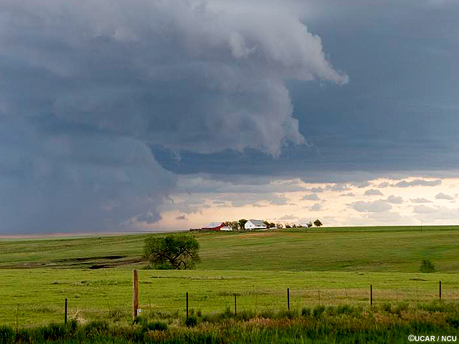

Slide 10
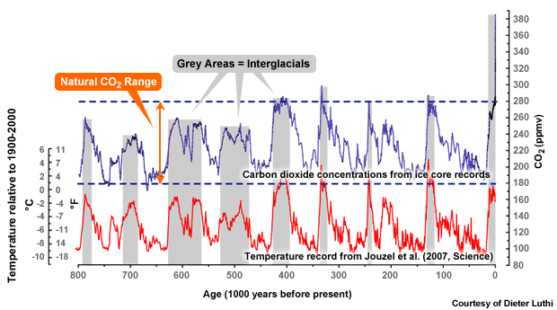
Could the warming be natural?
Notes:
Certainly, past temperatures past have been higher (and lower) than today, and
CO₂ concentrations have also varied. Large global swings were probably caused by such things as changes in Earth’s orbit, which changed the distribution of sunlight over the planet. When this caused warming, more CO2 and other greenhouse gases were released, producing additional warming.
[click to reveal today’s CO2 level] But today, the CO₂ released by human activities is far above amounts in the previous 800,000 years. This CO2 is triggering the increase in temperatures we’ve seen.

Slide 11
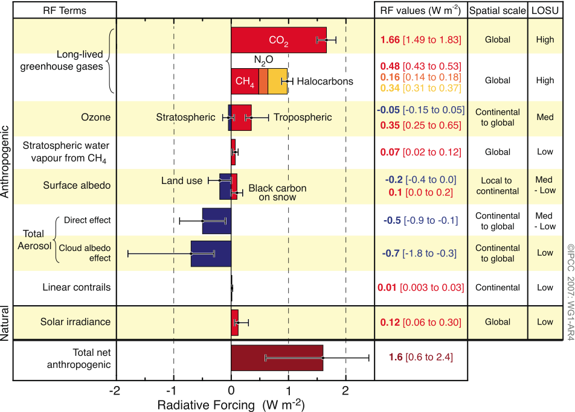
Estimaciones del forzamiento radiativo
Notes:
Figure SPM.2. Global average radiative forcing (RF) estimates and ranges in 2005 for anthropogenic carbon dioxide (CO₂), methane (CH₄), nitrous oxide (N₂O) and other important agents and mechanisms, together with the typical geographical extent (spatial scale) of the forcing and the assessed level of scientific understanding (LOSU). The net anthropogenic radiative forcing and its range are also shown. These require summing asymmetric uncertainty estimates from the component terms, and cannot be obtained by simple addition. Additional forcing factors not included here are considered to have a very low LOSU. Volcanic aerosols contribute an additional natural forcing but are not included in this figure due to their episodic nature. The range for linear contrails does not include other possible effects of aviation on cloudiness. {2.9, Figure 2.20}
forzamiento radiativo en clima significa cualquier cambio en la radiación (calor) entrante o saliente de un sistema climático. Puede deberse a cambios en la radiación solar incidente, o a diferentes cantidades de gases activos radiativos.

Slide 12
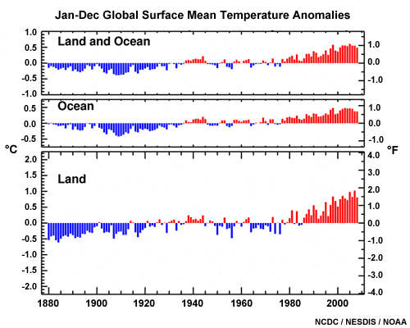
El cambio es real
Notes:
Earth is getting warmer by virtually every measure we know, and the temperature has been well above normal for more than 25 years. Although increases of 1.0-1.6°F (0.6-0.9°C) over the last century or so may not sound very threatening, remember that’s a global average. The warming is stronger over land than over oceans and in the higher latitudes than in the tropics.

Slide 14
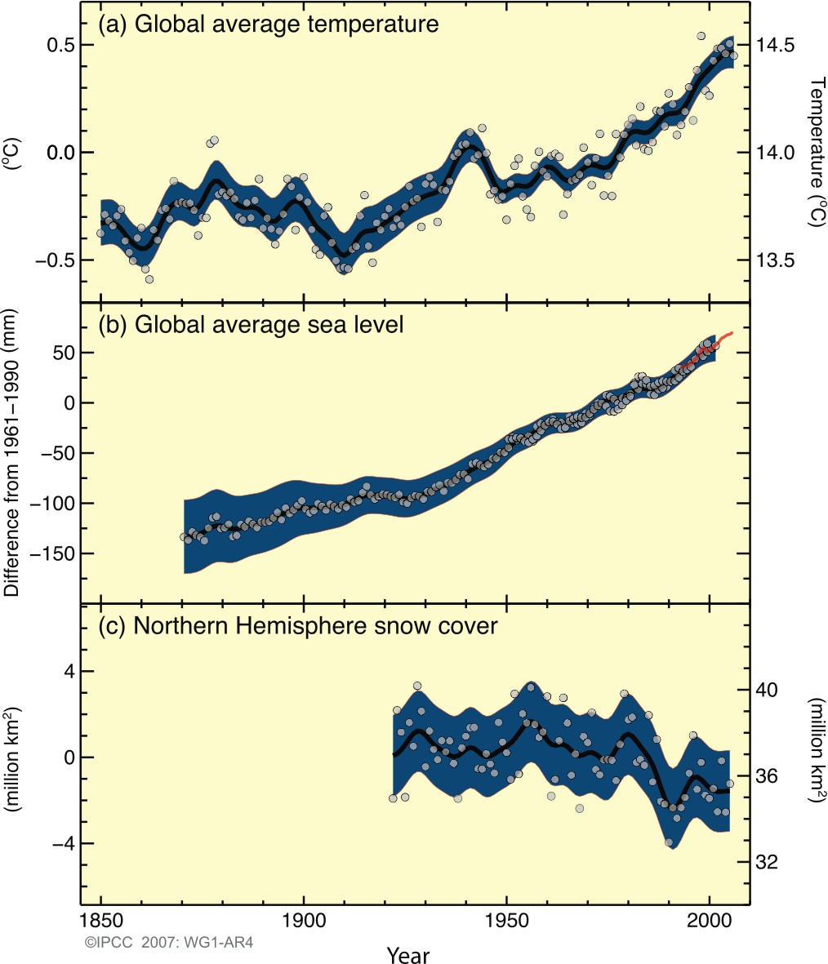
Registros históricos de cambios climáticos
El calentamiento del sistema climático es inequívoco. Es evidente a partir de las observaciones de los aumentos en las temperaturas promedio mundiales del aire y los océanos,
derretimiento generalizado de la nieve y el hielo, y aumento del nivel medio del mar.
March-April
Notes:
Figure SPM.3. Observed changes in (a) global average surface temperature, (b) global average sea level from tide gauge (blue) and satellite (red) data and (c) Northern Hemisphere snow cover for March-April. All changes are relative to corresponding averages for the period 1961–1990. Smoothed curves represent decadal average values while circles show yearly values. The shaded areas are the uncertainty intervals estimated from a comprehensive analysis of known uncertainties (a and b) and from the time series (c). {FAQ 3.1, Figure 1, Figure 4.2, Figure 5.13}

Slide 16
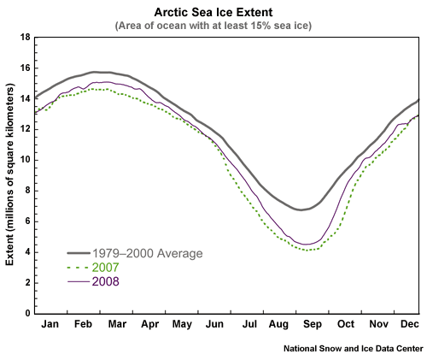
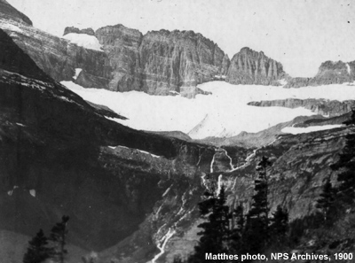
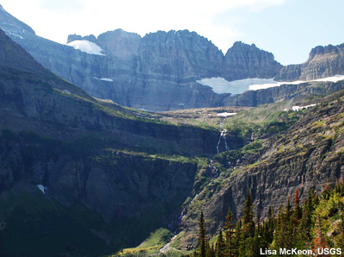
Derretimientos
Grinnell Glacier, Glacier National Park
1900 and 2008
Notes:
[Image 1] Snow and ice reflect the sun’s energy back to space. Without this white cover, more water can evaporate into the atmosphere where it acts as a greenhouse gas, and the ground absorbs more heat. Snow and ice are melting at rates unseen for thousands of years. In Glacier National Park, for example, there were 150 glaciers in 1850. Today, there are 26.
[click, Image 2] Sea ice is dwindling too, especially in the Northern Hemisphere. Satellites have seen average Arctic sea ice shrink by 2.7% per decade from 1978 to 2006, with faster melting in summer.

Slide 17
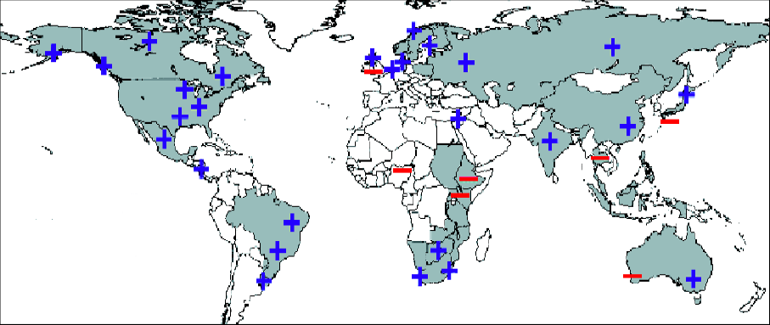
Aumento de la proporción de eventos extremos de precipitaciones
NH Winter
NH Summer
La frecuencia de eventos de precipitación intensa ha aumentado en la mayoría de las áreas terrestres, lo que concuerda con el calentamiento y los aumentos del vapor de agua atmosférico, mientras que se han observado sequías más intensas y prolongadas desde la década de 1970, particularmente en los trópicos y subtrópicos.
Notes:
Figure SPM.7. Relative changes in precipitation (in percent) for the period 2090–2099, relative to 1980–1999. Values are multi-model averages based on the SRES A1B scenario for December to February (left) and June to August (right). White areas are where less than 66% of the models agree in the sign of the change and stippled areas are where more than 90% of the models agree in the sign of the change. {Figure 10.9}

Slide 18
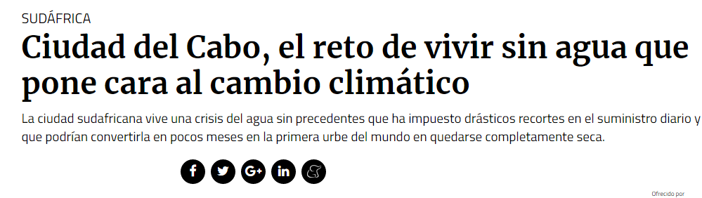
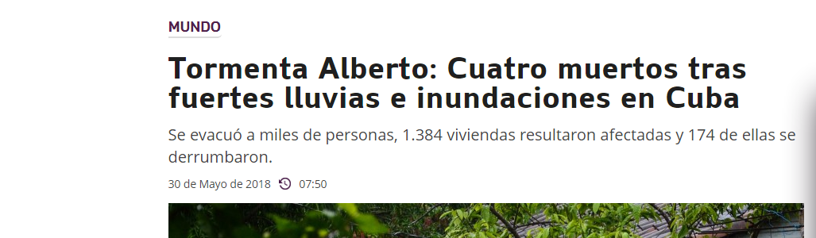

Slide 19
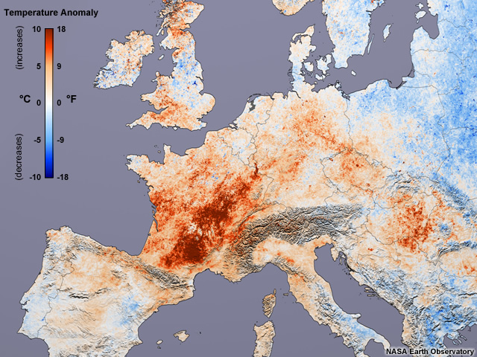
U.K.: Train rails buckle
Germany: Lowest river levels this century
France: >14,000 muertes
Switzerland: Melting glaciers, avalanches
Portugal: incendios Forestales inmensos
2003 European Heat Wave
Notes:
[Image 1] There will always be natural variability, and some places and some years will be warmer or cooler than average. In general, however, summers will get hotter, not only because of higher temperatures but also because humidities will increase. That means that heat waves, like the one that killed 35,000 people in Europe in 2003, will become more common.
[click, Image 2] On the plus side, winters will be warmer in many places, reducing heating bills. And the number of days with frosts is likely to decrease.

Slide 20
Qué puede pasar?

Slide 21
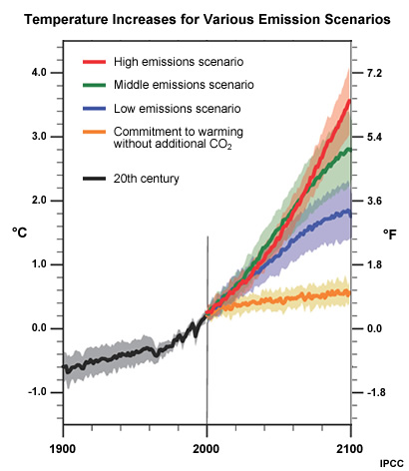
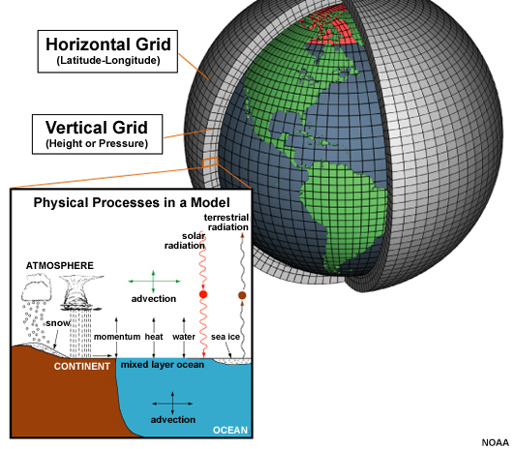
Modelos climáticos
Notes:
[Image 1] The main tool for both past and present climate analyses are computer climate models. Much like the models used to forecast weather, climate models simulate the climate system with a 3-dimensional grid that extends through the land, ocean, and atmosphere. The grid may have 10 to 60 different levels in the atmosphere and surface grid spacings of about 60 by 90 miles (100 by 150 km)—the size of Connecticut. The models perform trillions of calculations that describe changes in many climate factors in the grid.
[click, Image 2] The models project possible climates based on scenarios that cover a range of assumptions about global population, greenhouse gas emissions, technologies, fuel sources, etc. The model results provide a range of possible impacts based on these assumptions.

Slide 22
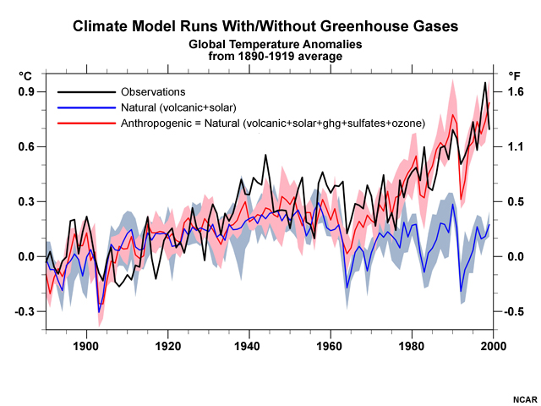
Notes:
Climate models are not only used to look at how climate might change, they’re also used to figure out WHY it’s changing. When models are run with only natural influences from the sun and volcanic eruptions, they say that during the latter half of the 20th century, we would have expected little change from normal conditions (the blue line). Only the addition of human emissions (greenhouse gases, sulfates, and ozone) produce the model results in red that most closely reproduce the black line of actual observations.
So, although they aren’t perfect, climate models can reproduce many of the larger features of climate change in Earth’s distant past, and they replicate the pattern of warming in the last 100+ years. This gives us confidence that they correctly identify that the warming is due to man’s activities, and that projections of future warming are realistic.

Slide 23
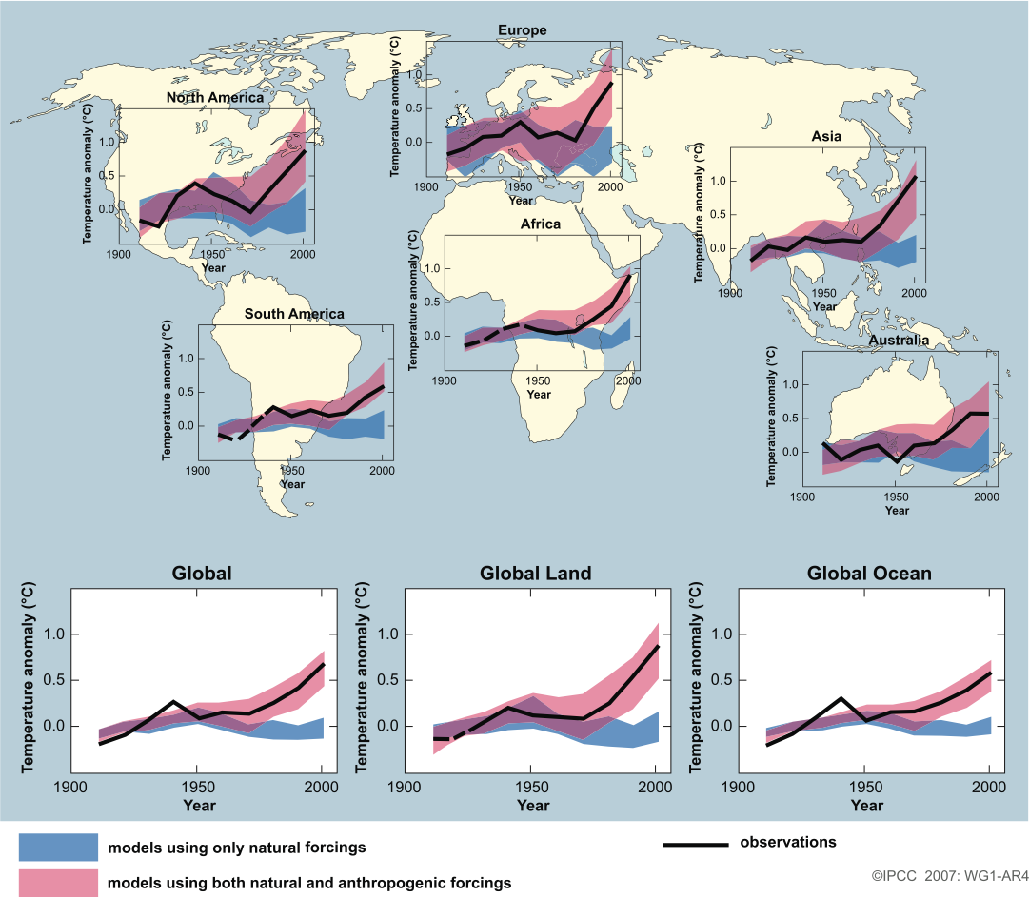
Observed & simulated continental & global scale changes in surface temperature
cambio observado (línea negra); simulaciones de modelos climáticos utilizando forzamientos naturales (azules) y antropogénicos (rojos)
observado
Notes:
Figure SPM.4. Comparison of observed continental- and global-scale changes in surface temperature with results simulated by climate models using natural and anthropogenic forcings. Decadal averages of observations are shown for the period 1906 to 2005 (black line) plotted against the centre of the decade and relative to the corresponding average for 1901–1950. Lines are dashed where spatial coverage is less than 50%. Blue shaded bands show the 5–95% range for 19 simulations from five climate models using only the natural forcings due to solar activity and volcanoes. Red shaded bands show the 5–95% range for 58 simulations from 14 climate models using both natural and anthropogenic forcings. {FAQ 9.2, Figure 1}

Slide 24
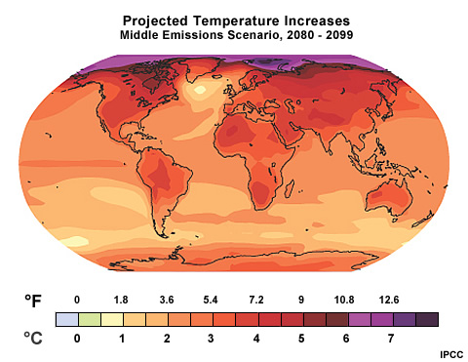
Aspen, CO Forecast:
Partly cloudy today
High : 28°F
Low: 13°F
Increasing clouds over night. Colder tomorrow.
Notes:
[Image 1] A common critique of climate predictions is, “If weather model forecasts aren’t reliable more than a week out, how can models predict climate decades in the future?” While weather and climate models are based on similar physics, they are not predicting the same thing. Weather forecasts look at the day-to-day changes on a local level, and subtle chaotic atmospheric variations make short-term weather forecasts difficult beyond 8-10 days.
[click, Image 2] Climate predictions are focused on longer-term influences of the sun, oceans, land, and ice on the atmosphere. Instead of predicting a temperature at a particular place at a particular hour, climate modules project an average temperature over a year or longer in a large region or over the entire globe.

Slide 25
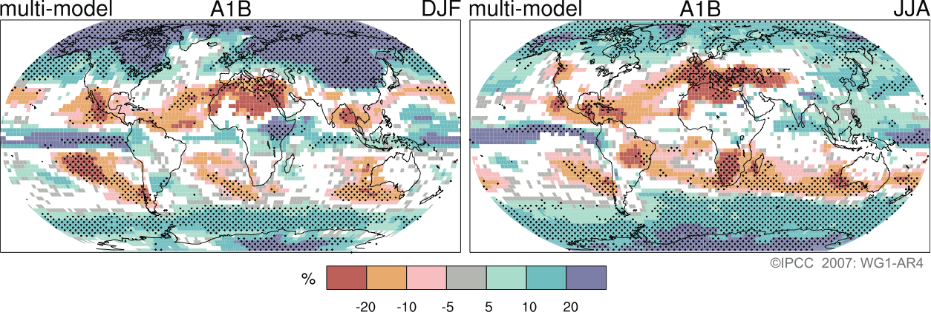
Cambio en las precipitaciones para el período 2090–2099
(relative to 1980–1999)
NH Winter
NH Summer
Clima más cálido -> Más vapor de agua en la atmósfera
pero un cinturón expandido de aridez subtropical
Notes:
Figure SPM.7. Relative changes in precipitation (in percent) for the period 2090–2099, relative to 1980–1999. Values are multi-model averages based on the SRES A1B scenario for December to February (left) and June to August (right). White areas are where less than 66% of the models agree in the sign of the change and stippled areas are where more than 90% of the models agree in the sign of the change. {Figure 10.9}

Slide 26
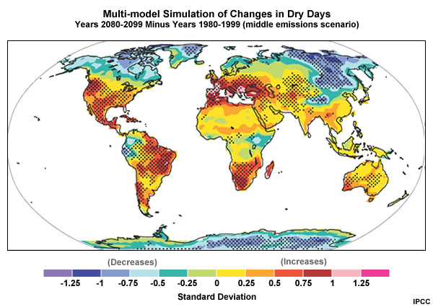
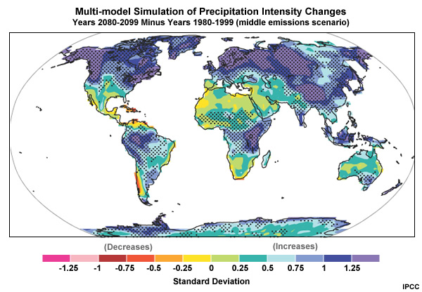
Efecto en precipitaciones
Notes:
[Image 1] More water vapor held by a warmer atmosphere also leads to heavier rains and more snowfall. Intense precipitation over the U.S. has increased 20% over the last century.
[click, Image 2] But as storm tracks shift, it can also mean some areas get drier. A 2004 study by the National Center for Atmospheric Research found that the percentage of Earth’s land experiencing serious drought had more than doubled since the 1970s.

Slide 27
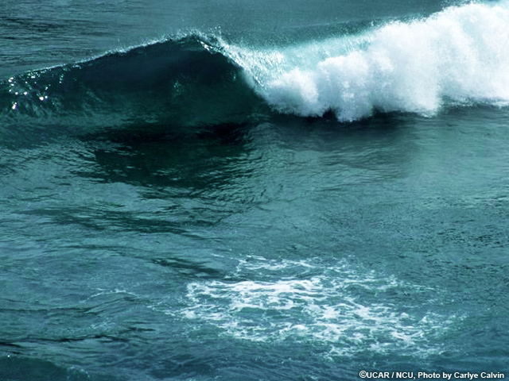
Proyecciones de aumento del nivel del mar: algunas pulgadas a unos pocos pies
60 cm: EE. UU. Perdería 10,000 millas cuadradas
90 cm pies: inundaría Miami
Afecta la erosión, la pérdida de humedales, suministros de agua dulce
La mitad de la población mundial vive a lo largo de las costas
Notes:
The oceans will continue their rise in the coming century. The IPCC’s best estimates range from a few inches to a few feet by 2100. If the rise is 2 feet, the US could lose 10,000 square miles, If they rise three, they will inundate Miami and most of coastal Florida. Sea-level rise also increases coastal erosion and the loss of coastal wetlands, and saltwater spoils freshwater drinking supplies. Coastal populations become even more vulnerable to storm surge and flooding. Considering that half of the world’s population lives near coasts, sea-level rise is a serious concern.
The big unknown in all this is how much the planet’s ice sheets will melt.

Slide 28
Algunos Impactos

Slide 29



El nicho Climático, y el Cambio Climático
Temperatura media
Precipitación anual
Rango diurno de temperaturas

Slide 30


El nicho Climático, y el Cambio Climático
RANGO AMBIENTAL
Temp max del verano
Precipitación anual
Rango diurno de temp.

Slide 31

El nicho Climático, y el Cambio Climático
RANGO AMBIENTAL
Temp max del verano
Precipitación anual
Rango diurno de temp.
Notes:
Aca mencionar que se espera que las espcies mas expuestas sean aquellas con posiciones o requerimientos marginales de nicho climático, y auqellas que poseen nichos chiquitos. Porque cualquier movimiento en cualquier variables los puede afectar.

Slide 32


El Nicho Climático y el Cambio Climático
??
??
Notes:
Mencionar no solo que se mueven a los polos, tb que las que ya están arriba, pueen no tener dde migrar.
TODAS ESTAS MIGRACIONES Y MOVIMIENTOS TIENEN MUCHAS VARIABLES, ESTAN MUY ASOCIADAS POR EJEMPLO A LA CAPACIDAD DE LAS ESPCIES DE MOVERSE COMO TB A LA PRESECIA DE BARRERAS QUE LIMITEN LA MIGRACION Y POR ENDE ACOTEN EL NICHO CLIMATICO DE LA ESPECIE.

Slide 33
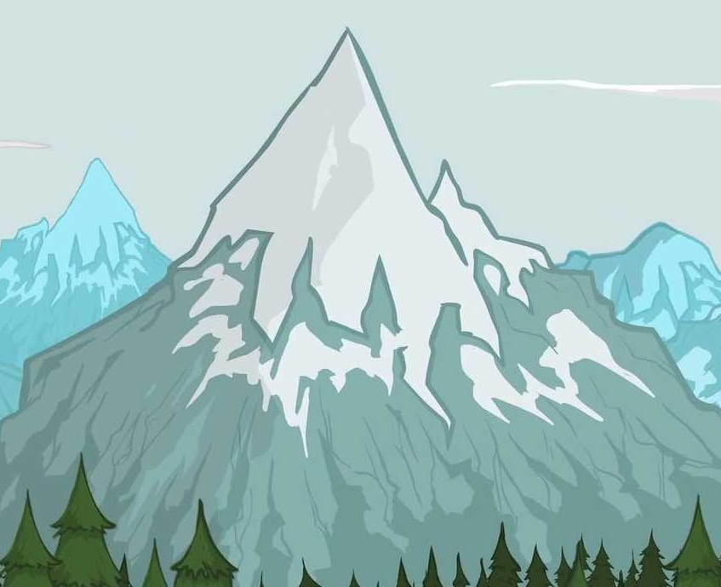
??

Slide 34
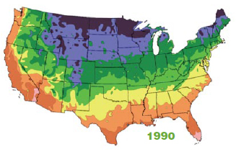
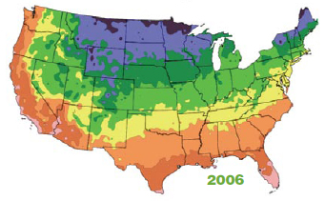
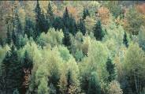
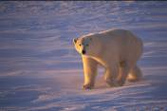
Cambios de Rango
National Academy of Sciences
National Academy of Engineering
Institute of Medicine
National Research Council
Reubicación de especies a zonas con climas favorables
Especies particularmente amenzadas
  Baja vagilidad
  Dependen de ambientes poco frecuentes o extremos.
Fitoregiones de USA, 1990 and 2006.
Notes:
See Ecological Impacts of Climate Change booklet, p. 8-9
About 40 percent of wild plants and animals that have been studied over decades are relocating to stay within their tolerable climate ranges.
Some organisms—those that cannot move fast enough or those whose ranges are actually shrinking—are being left with no place to go. For example, as arctic sea ice shrinks, so too shrink the habitats of animals that call this ice home, such as polar bears and seals. As these habitats contract toward the North and South poles, the animals that depend on them will reach the end of the Earth as they know it.
We will see specific examples of range shifts in some of the geographic area slides (such as the Checkerspot butterflies in the Pacific Coastline and the American Pika in the Western Mountains).

Slide 35

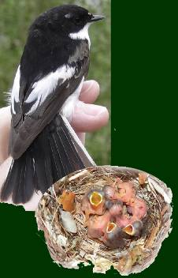
Desfasajes temporales
National Academy of Sciences
National Academy of Engineering
Institute of Medicine
National Research Council
Algunas actividades biologicas estacionales estan ocurriendo hasta 1 mes antes
  Floración de arboles
  Migración de pajaros
  Metamorfósis de insectos
Esto genera disrupción en procesos ecológicos
Los pollitos piedcatcher europeos ahora nacen más tarde que las orugas que comen.
Images used under the terms of the GNU Free Documentation License.
Notes:
See Ecological Impacts of Climate Change booklet, p. 9
If all of the species in an ecosystem shifted their seasonal behavior in exactly the same way, shifts in the timing of biological activity might not create problems. But when a species depends upon another for survival and only one changes its timing, these shifts can disrupt important ecological interactions, such as that between predators and their prey.
For example, the European pied flycatcher has not changed the time it arrives on its breeding grounds even though the caterpillars it feeds its young are emerging earlier. Missing the peak of food availability means fewer chicks are surviving, in turn causing the flycatcher’s population to decline.
How might earlier blooming of trees and flowers affect other species?
What about the species that pollinate them?

Slide 36
CAMBIO CLIMATICO GLOBAL
javiernori@gmail.com

