Slide 1
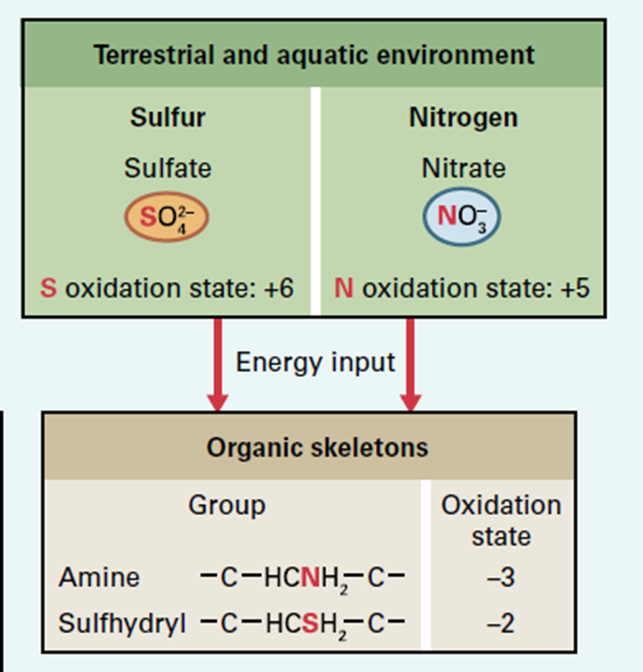
Asimilación de
Nutrientes Minerales

Slide 2
How do plants optimize their uptake and utilization of nitrogen?
How is inorganic nitrogen assimilated into organic molecules?
How do plants sense local soil nitrogen levels and plant nitrogen status?
How do plants remobilize nitrogen to optimize N-utilization?
How is nitrogen taken up into the plant?
How do plants respond to nitrogen deficit? How do they maximize uptake through their roots?

Slide 3
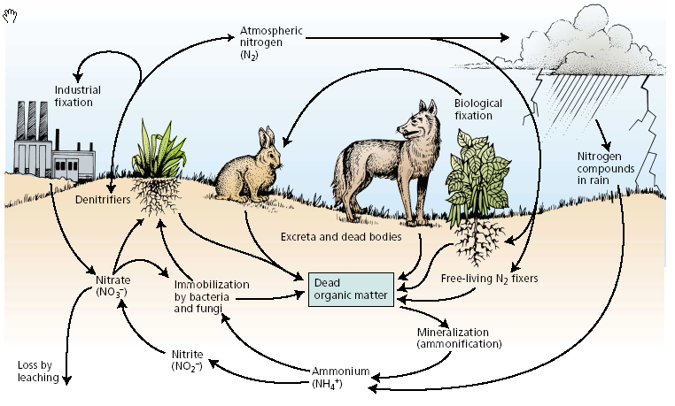
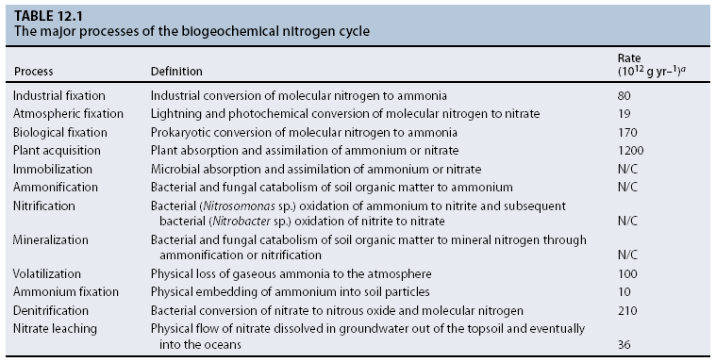

Slide 4
Nitrogen can be found in many inorganic forms
Species | Name | Oxidation State
R-NH₂ | Organic nitrogen, urea | -3
NH₃, NH₄⁺ | Ammonia, ammonium ion | -3
N₂ | Nitrogen | 0
N₂O | Nitrous oxide | +1
NO | Nitric oxide | +2
HNO₂, NO₂⁻ | Nitrous acid, nitrite ion | +3
NO₂ | Nitrogen dioxide | +4
HNO₃, NO₃⁻ | Nitric acid, nitrate ion | +5
NO₂⁻
Nitrite oxidation
Nitrification
Ammonia
oxidation
NO₃⁻
Nitrate reduction
Aerobic reactions
NH₃
Anaerobic reactions
NO₂⁻
NO
N₂O
Nitrogen fixation
Denitrification
N₂
Adapted from Robertson, G.P. and Vitousek, P.M. (2009). Nitrogen in agriculture: Balancing the cost of an essential resource. Annu. Rev. Environ. Res. 34: 97-125.

Slide 5
Most plants take up most of their nitrogen as nitrate NO₃⁻
Many prokaryotes oxidize NH₄⁺, so soil NH₄⁺ levels are often low
Plants use energy to reduce NO₃⁻ for assimilation into organic compounds
Energy released
Energy released
Energy consumed
Energy consumed
NH₄⁺
NO₂⁻
NO₃⁻
NO₃⁻
NO₂⁻
NH₄⁺
R-NH₃
Nitrification by nitrifying prokaryotes
Nitrate reductase
Nitrite reductase
Plant preferences for NH₄⁺ vs NO₃⁻ vary by species, other metabolic processes, temperature, water, soil pH etc….
See Li, B., Li, G., Kronzucker, H.J., Baluška, F. and Shi, W. (2014). Ammonium stress in Arabidopsis: signaling, genetic loci, and physiological targets. Trends Plant Sci. 19: 107-114; Britto, D.T. and Kronzucker, H.J. (2013). Ecological significance and complexity of N-source preference in plants. Ann. Bot. 112: 957-963.

Slide 6
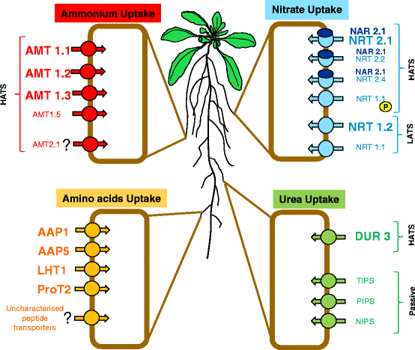
Plants have specific transporters for NO₃⁻, NH₄⁺ and other N forms
HATS = high affinity transporters
LATS = low affinity transporters
Nacry, P., Bouguyon, E. and Gojon, A. (2013). Nitrogen acquisition by roots: physiological and developmental mechanisms ensuring plant adaptation to a fluctuating resource. Plant Soil. 370: 1-29, With kind permission from Springer Science and Business Media
Notes:
Schematic representation of the membrane transporters involved in the root uptake of the four major sources of nitrogen in Arabidopsis thaliana plants. Proteins are grouped according to their substrate and to their affinity for the substrate (HATS High Affinity transporters and LATS Low affinity transporters). Transporters highlighted with big letters are those that play a major role in nutrient uptake. Question marks represent unconfirmed results. Several amino acid and peptide transporters have been identified in heterologous system but there in planta function have not yet been characterised. NRT1-1 is both a LATS and HATS depending on phosphorylation of the threonine 101 residue. NAR2.1 is a protein of unknown function that is mandatory to ensure nitrate transport by NRT2 transporters

Slide 7

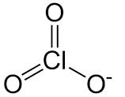
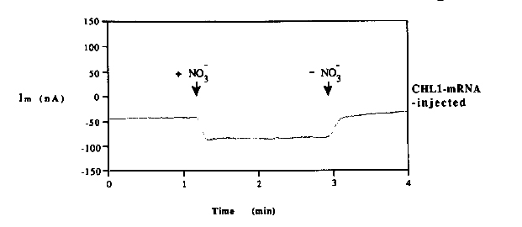
A major nitrate importer was the first cloned: CHL1/ NRT1.1/ NPF6.3
The first nitrate transporter was identified using a genetic selection for chlorate resistance
Chlorate (ClO₃⁻) mimics nitrate (NO₃⁻)
Toxic
Nitrate reductase
Chlorite
ClO₂⁻
Nitrate reductase mutant
Chlorate uptake mutant
(chl1-5)
In 1993 the CHL1 gene was cloned and found to be a nitrate transporter (shown = current in Xenopus oocytes)
Wild-type
1973
Growth on chlorate
Nitrate reductase activity
-
+
+
Oostindiër-Braaksma, F.J. and Feenstra, W.J. (1973). Isolation and characterization of chlorate-resistant mutants of Arabidopsis thaliana. Mutation Research/Fundamental and Molecular Mechanisms of Mutagenesis. 19: 175-185; Reprinted from Tsay, Y.-F., Schroeder, J.I., Feldmann, K.A. and Crawford, N.M. (1993). The herbicide sensitivity gene CHL1 of arabidopsis encodes a nitrate-inducible nitrate transporter. Cell. 72: 705-713 with permission from Elsevier.

Slide 8
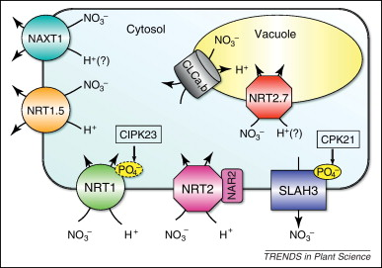
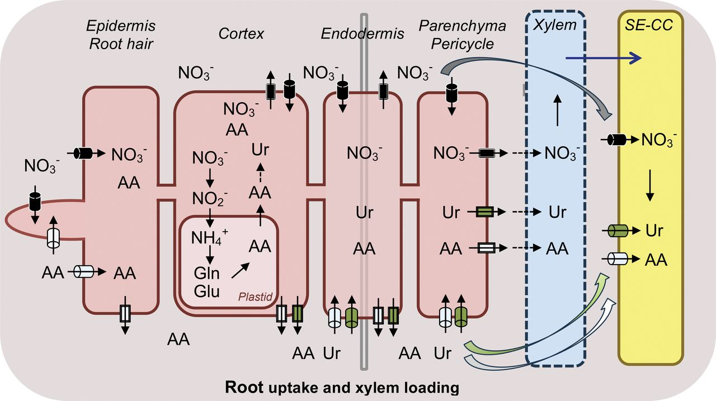
Other channels contribute to nitrate transport w/in and between cells
Nitrogen uptake but also assimilation and recycling depend on membrane transporters
Specific transporters move nitrate (or other N-containing compounds) inwards and outwards across the PM and across the vacuolar membrane
Reprinted from Wang, Y.-Y., Hsu, P.-K. and Tsay, Y.-F. (2012). Uptake, allocation and signaling of nitrate. Trends Plant Sci. 17: 458-467 with permission from Elsevier; Tegeder, M. (2014). Transporters involved in source to sink partitioning of amino acids and ureides: opportunities for crop improvement. J. Exp. Bot. 65: 1865-1878 by permission of Oxford University Press.

Slide 9
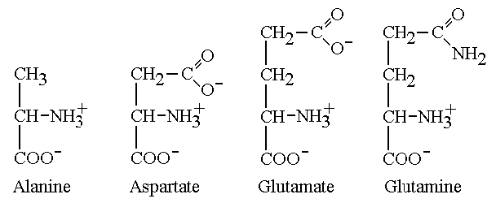
Primary N assimilation: NO₃⁻ is reduced to NH₄⁺ prior to assimilation
Uptake
Glutamate
NH₄⁺
Assimilation into organic compounds
Nitrite reductase
NH₄⁺
NO₂⁻
Nitrate reductase
All other N-containing compounds
Glutamine synthetase (GS)
Glutamine
NO₃⁻
NO₃⁻
R-NH₃

Slide 10
Nitrate responses
Short term responses
Long term responses
Primary
Secondary
Reprogramation
carbon assimilat
Changes in root growth
and architecture
NRT 1.1
NRT 2.1
NIA NiR
Root to shoot ratio
Redistribution of
chemical energy
Germination rates

Slide 11



Reducción de Nitratos
La acumulación de nitratos, nitritos y amonio
pueden resultar tóxicos para plantas y animales
Metahemoglobinemia
Nitrosaminas
Agente desacoplante

Slide 12
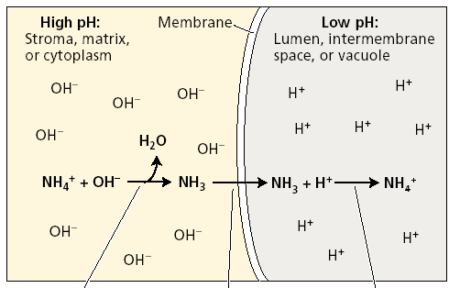
La Reducción de Nitrato es un proceso estrictamente controlado

Slide 13
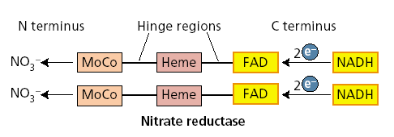
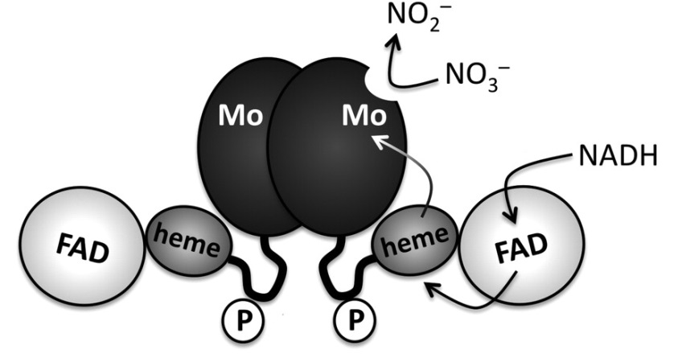
Primer paso: NITRATO REDUCTASA

Slide 14
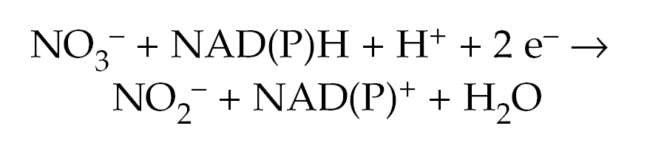
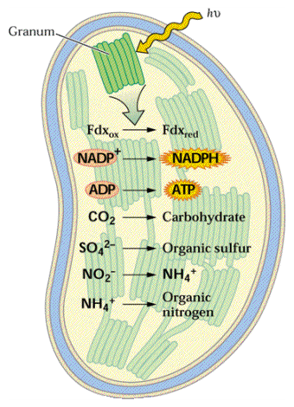
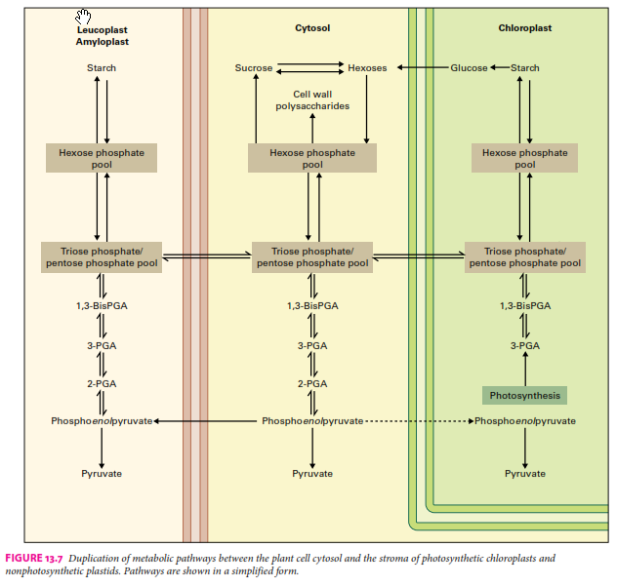

Slide 15
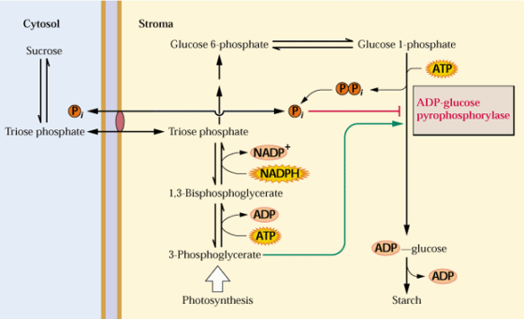
Lanzadera (permeasa) de triosas fosfato: trasporte de esqueletos carbonados, equivalentes de reducción y ATP

Slide 16
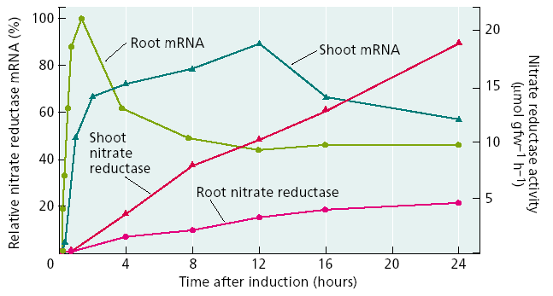
Regulación transcripcional

Slide 17
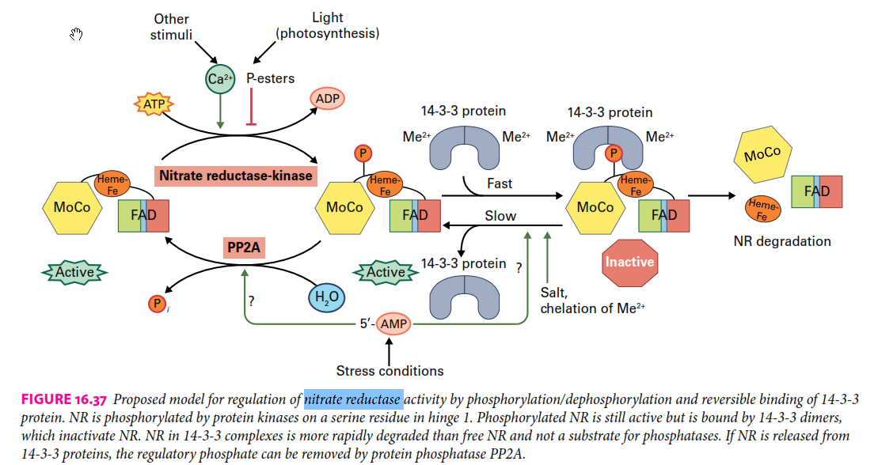
Regulación postranscripcional

Slide 18
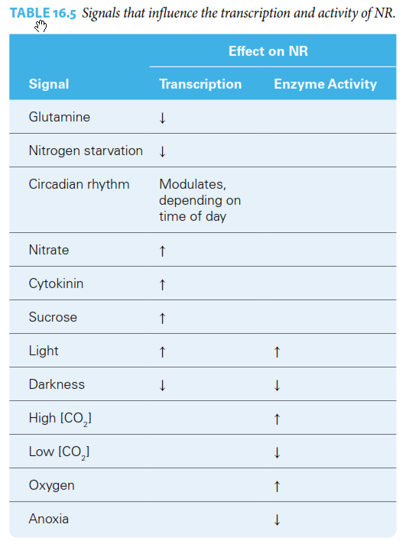

Slide 19
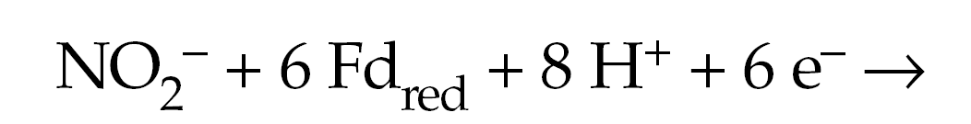
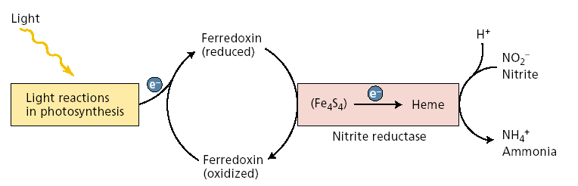
Segundo paso: NITRITO REDUCTASA
Pentosas fosfato

Slide 20
Citosol
Cloroplasto
2-OG
Gln
2-OG
NR
NiR
NO₃⁻
NO₂⁻
NO₂⁻
NH₄⁺
1
2 e⁻
6 e⁻
Glu
Glu
NAD(P)H
Bombas
redox
Fd_{red}
Otros aa
Respiración
Fotosíntesis
2 e⁻
Modificado de Foyer & Noctor 2002
1: Sistema GS/ GOGAT

Slide 21
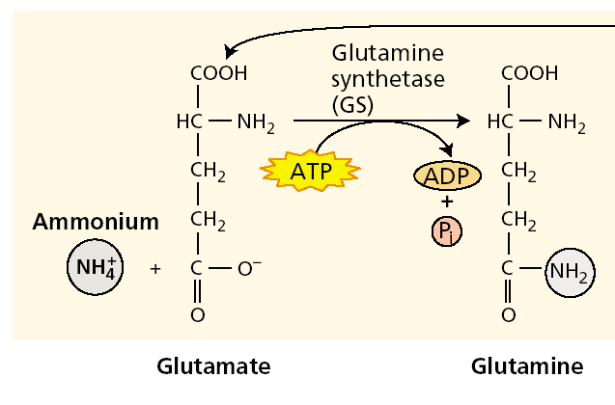
Primer paso: Glutamina Sintetasa

Slide 22
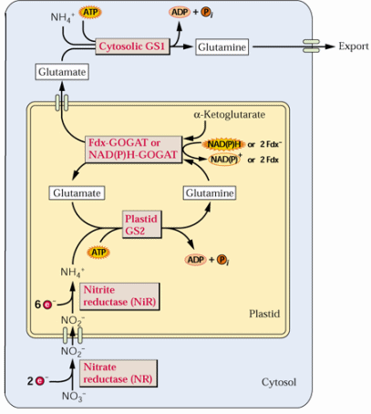

Slide 23
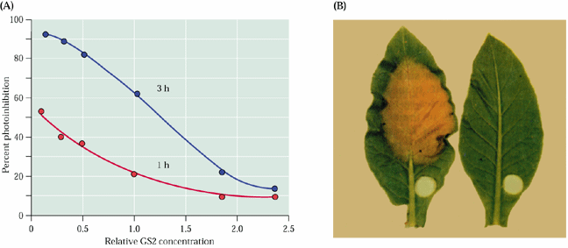
0
2,5
Sobrexpresión de GS2 en tabaco
A: fotoinhibición B: Alta intensidad de luz por 24 horas

Slide 24
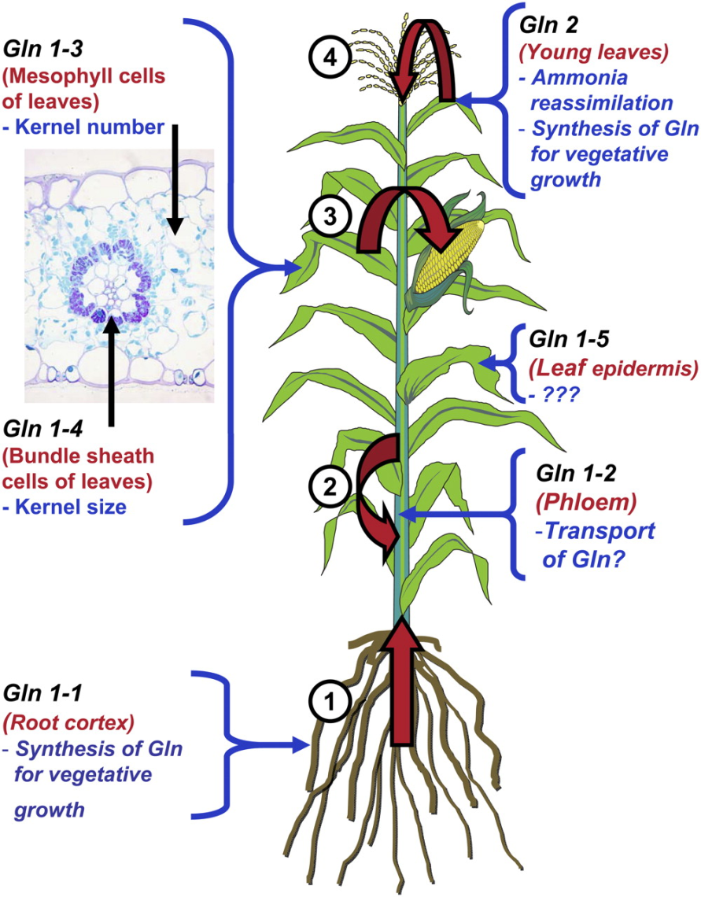
Gln synthetase (GS) expression is regulated by many factors
GS1 (GLN1 genes)
Cytosolic protein
GS2 (GLN2 genes)
Nuclear gene, plastid localized protein
GS activity is regulated transcriptionally and post-transcriptionally by
cell type,
light,
[NH₄⁺],
circadian cycles,
plant carbon status
GS activity is correlated with nitrogen use efficiency
Martin, A., et al., and Hirel, B. (2006). Two cytosolic glutamine synthetase isoforms of maize are specifically involved in the control of grain production. Plant Cell. 18: 3252-3274.

Slide 25
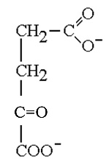
GS/GOGAT assimilates inorganic nitrogen into organic molecules
Remobilization
Amino acid recycling, photorespiration
Carbon pools
TCA cycle
Assimilation
Glutamate
2-oxoglutarate
Glutamine-2-oxoglutarate aminotransferase (GOGAT)
NH₄⁺
Uptake
Glutamate
Glutamine synthetase (GS)
Glutamine
Incorporation into amino acids and other nitrogen-containing compounds

Slide 26
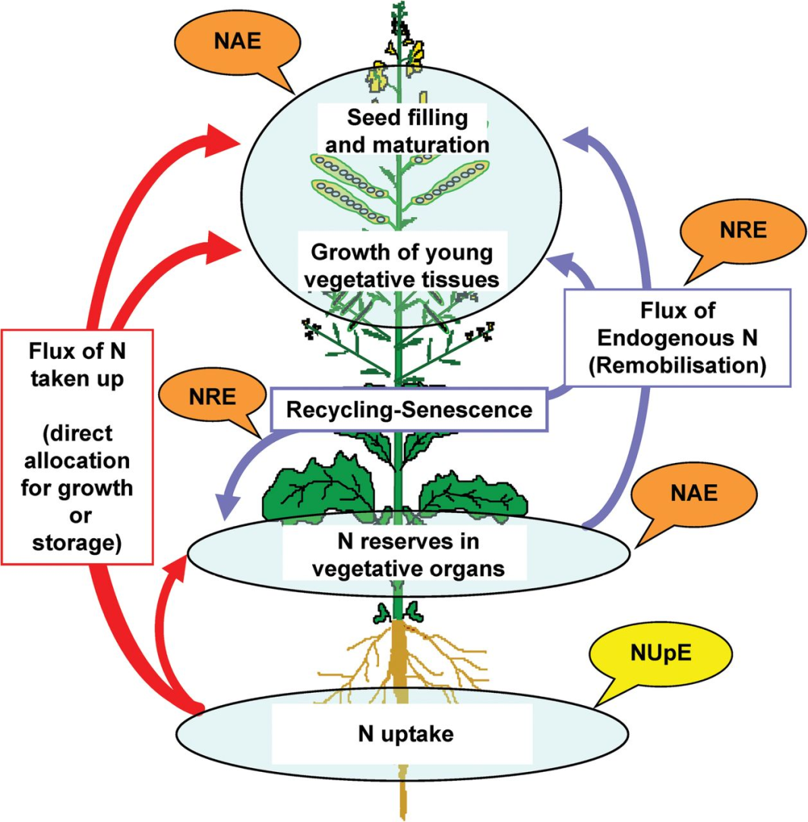
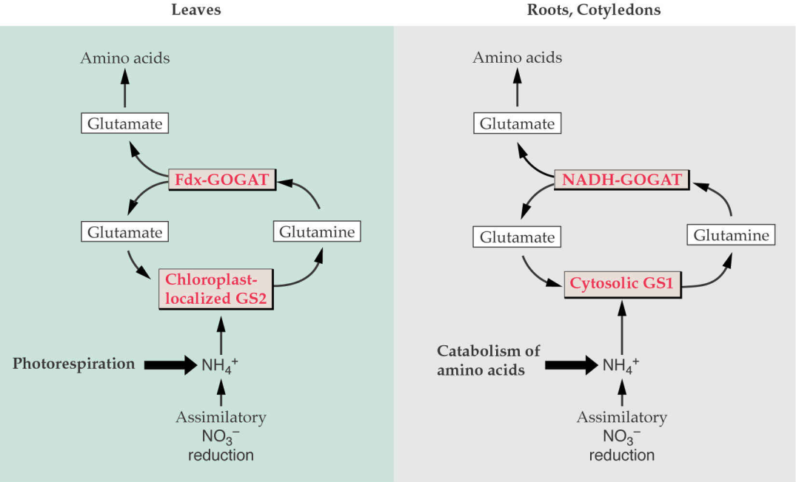
Rebmobilization of N occurs during senescence and photorespiration
Each N atom may cycle through GS many times as amino acids are recycled during growth and senescence and released due to photorespiration
assimilation
remobilization
Leaves
Roots, Cotyledons
Amino acids
Amino acids
remobilization
Glutamate
Glutamate
Fdx-GOGAT
NADH-GOGAT
Glutamate
Glutamine
Glutamate
Glutamine
assimilation
Chloroplast localized GS2
Cytosolic GS1
Photo-respiration
NH₄⁺
AA catabolism
NH₄⁺
uptake
Assimilation
Assimilation
Avice, J.-C. and Etienne, P. (2014). Leaf senescence and nitrogen remobilization efficiency in oilseed rape (Brassica napus L.). J. Exp. Bot. 65: 3813-3824 by permission of Oxford University Press.

Slide 27
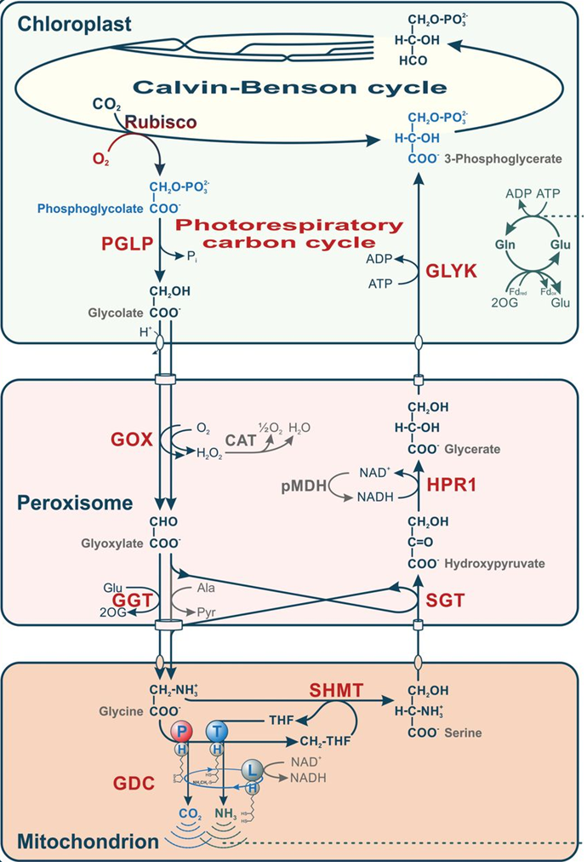

Slide 28
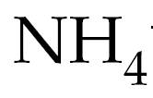
Asimilación del
Asimilación primaria
Reducción de Nitratos
Asimil. Sec. o reasimilación
Fotorrespiración
Fotorrespiración
10
Reducción de Nitratos
1

Slide 29
Segundo paso: Glutamato Sintasa
Fd-GOGAT
NADH-GOGAT

Slide 30
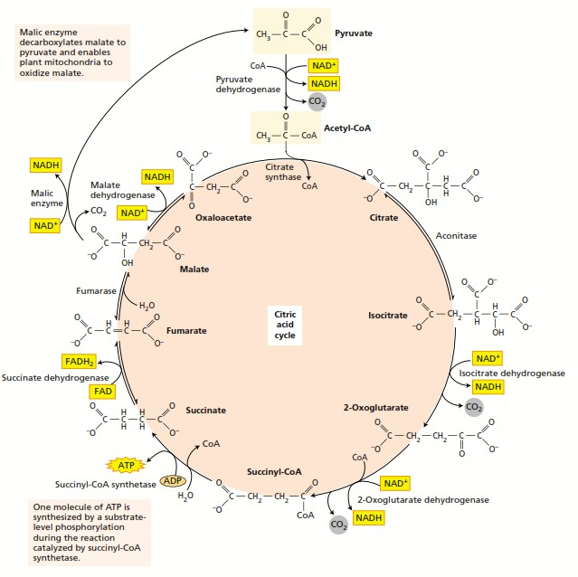
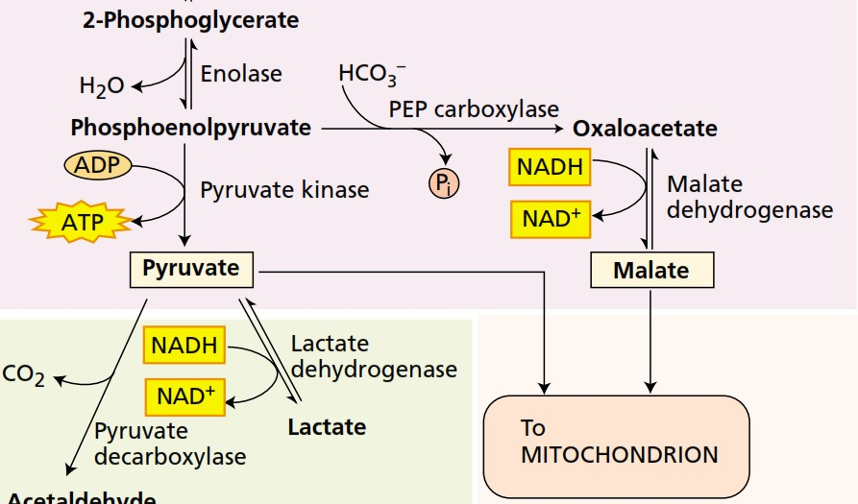
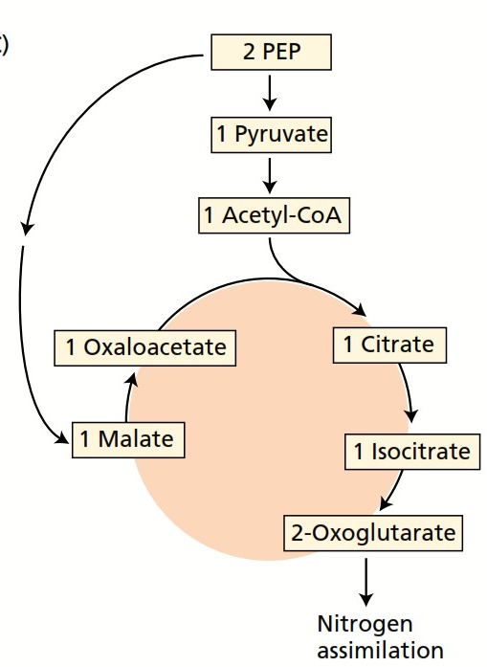

Slide 31
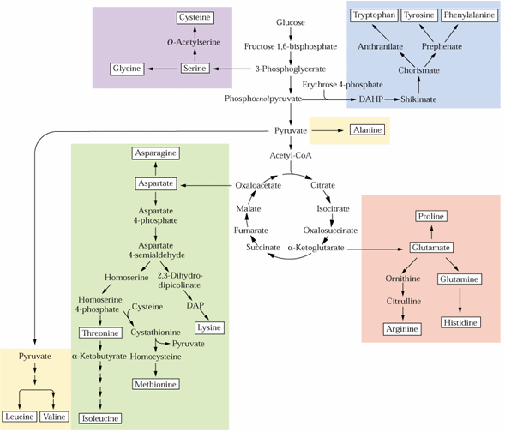
Integración del metabolismo del C
con el metabolismo del N

Slide 32
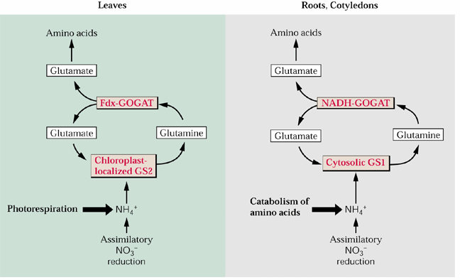

Slide 33
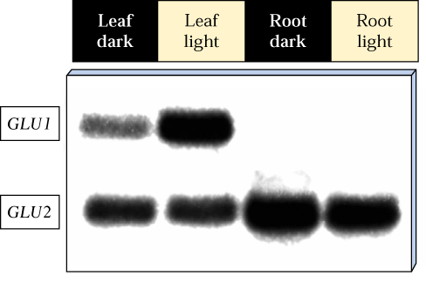

Slide 34
Summary: Plant nitrogen uptake and assimilation
Remobilization
Carbon pools
TCA cycle
Amino acid recycling, photorespiration
Assimilation
Uptake
Glutamate
2-oxoglutarate
NH₄⁺
Glutamine-2-oxoglutarate aminotransferase (GOGAT)
NH₄⁺
Nitrite reductase
Glutamate
NO₂⁻
Nitrate reductase
Glutamine synthetase (GS)
Glutamine
Incorporation into amino acids and other nitrogen-containing compounds
NO₃⁻
NO₃⁻
R-NH₂
NH₄⁺
Assimilation
N₂
Adapted from Xu, G., Fan, X. and Miller, A.J. (2012). Plant nitrogen assimilation and use efficiency. Annu. Rev. Plant Biol. 63: 153-182.

Slide 35
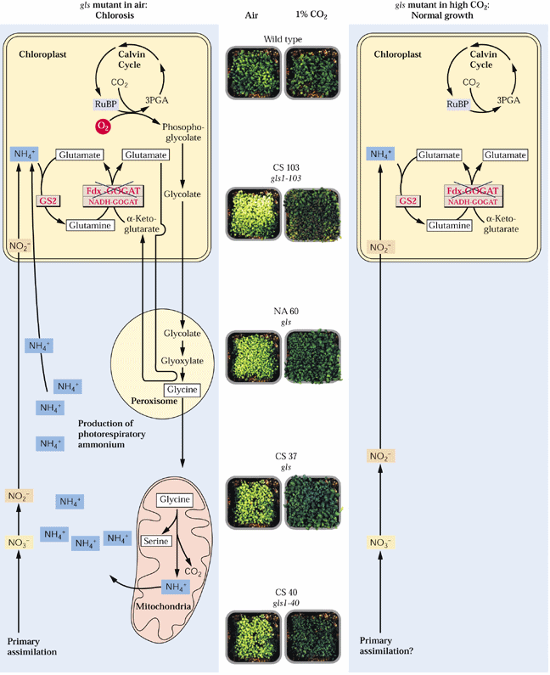

Slide 36
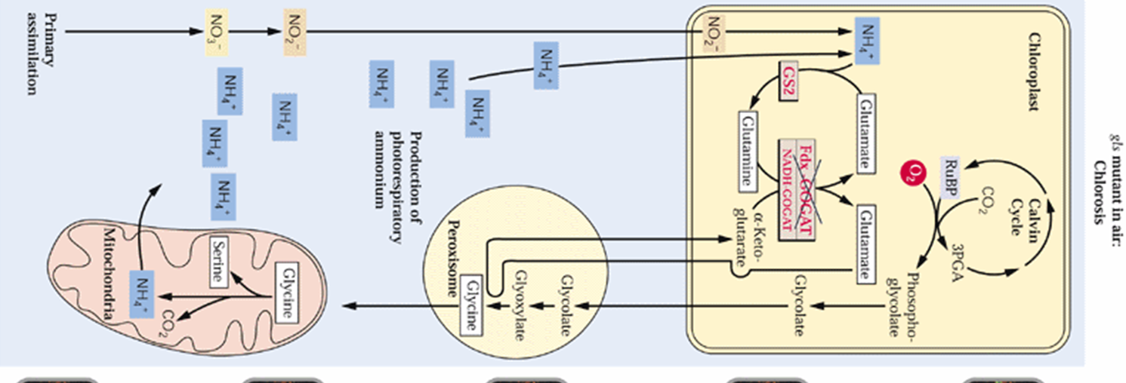
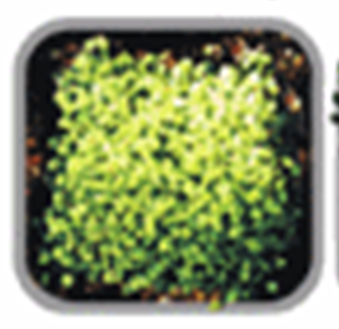
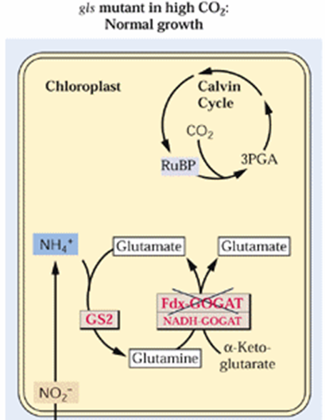

Slide 37
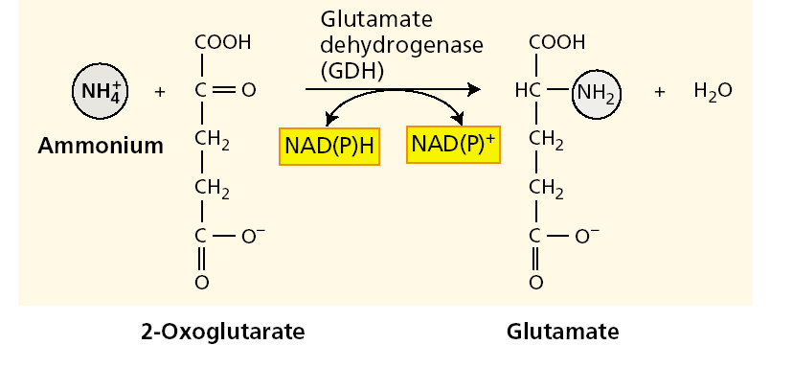
Otras vía de asimilación de NH₄⁺
NADH GDH en mitocondria
NADPH GDH en cloroplastos

Slide 38
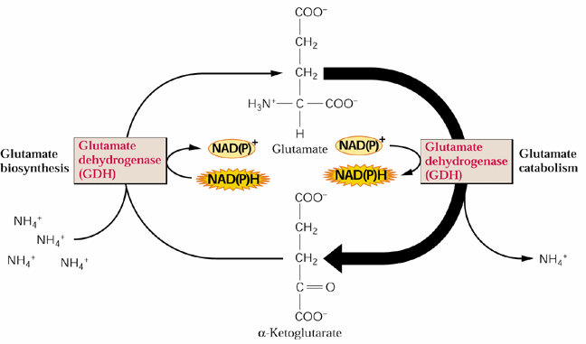

Slide 39
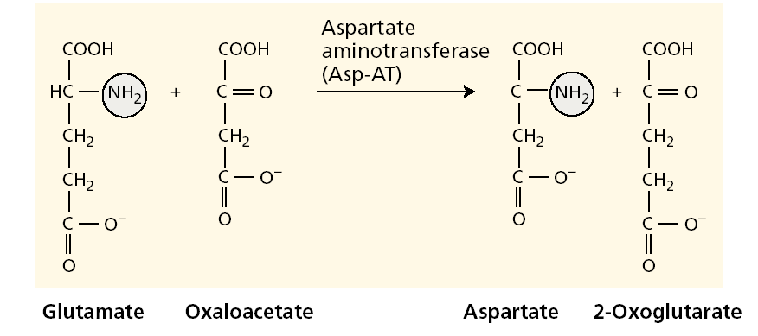
Glutamina – Glutamato
Fuente
Destino
Aspartato - Asparagina

Slide 40
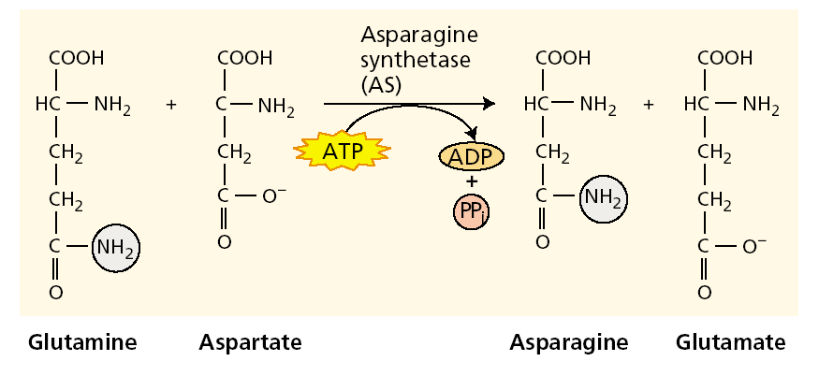
5:2
4:2

Slide 41
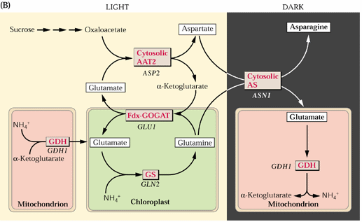

Slide 42
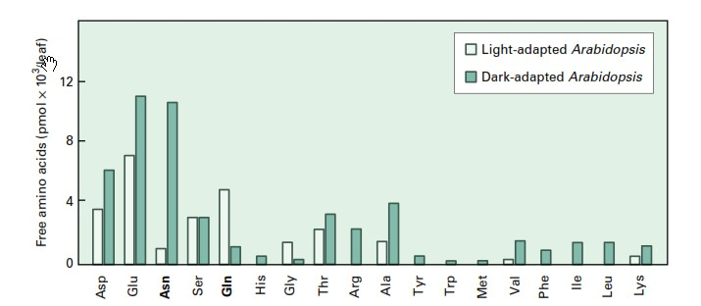

Slide 43
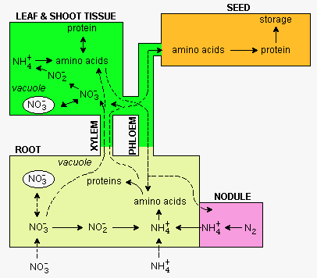

Slide 44
Nitrate responses
Short term responses
Long term responses
Primary
Secondary
Reprogramation
carbon assimilat
Changes in root growth
and architecture
NRT 1.1
NRT 2.1
NIA NiR
Root to shoot ratio
Redistribution of
chemical energy
Germination rates

Slide 45
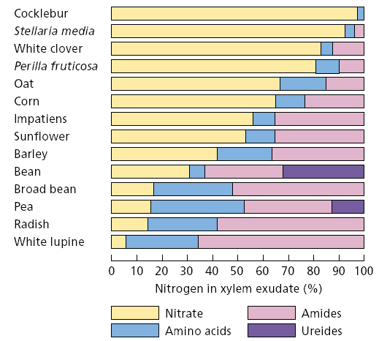
Observando la figura, puede Ud. decir en que parte de la planta
ocurre la reducción de NO3 y que parte de la planta se asimila el N?

Slide 46
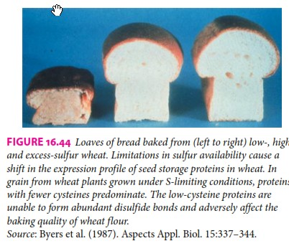

Slide 47
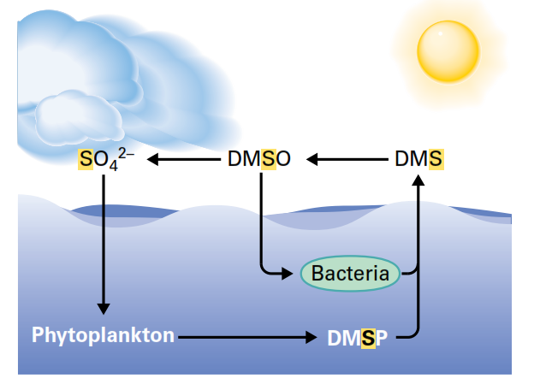

Ciclo del Azufre

Slide 48


Slide 49



Disulfide bridges in proteins play structural and regulatory roles
Sulfur participates in electron transport
through iron–sulfur clusters
Secondary metabolites

Slide 50

Absorción, almacenamiento, reducción y asimilación de S
selenate,
molybdate,
chromate

Slide 51



Slide 52

2) Sulfate reduction
(catalyzed by APS reductase)
APS reductase controls 90% of the reduction of internal sulfate into thiols and proteins

Slide 53

Sulfite is a
toxic anion
The amino acid sequence of the plant enzyme is also homologous to NiR, indicating sulfite and nitrite reductases emerged as a result of a gene dupli-
cation event.
Purified sulfite reductase from spinach (Spinacia oleracea) can reduce nitrite, although its affinity for nitrite is two orders of magnitude lower than for sulfite, its physiological substrate.

Slide 54

4) Assimilation

Slide 55


Slide 56


Slide 57

Glutatión (5 mM)
Estado redox celular
- potencial redox de -340 mV puede reducir dehidroascorbato a ascorbato
- reacciona químicamente con oxígeno singlete, superóxido y radicales hidroxilo, y por tanto, funciona directamente como un captador de radicales libres

Slide 58


Phytochelatins are small cysteine‐rich oligopeptides with the general structure

Slide 59


Slide 61


Sulfite oxidase
Peroxisome
Plants deficient in sulfite oxidase are more sensitive to treatment with bisulfite or to fumigation with SO₂ , while overexpression of the gene leads to increased protection.

Slide 62

Sulfate reduction 732 kJ mol⁻¹
Nitrate reduction 347 kJ mol⁻¹
Carbon reduction 478 kJ mol⁻¹
APReductasa

Slide 63

Deficiency for one element was shown to repress the other pathway

Slide 64

Asimilación de fosfatos

Slide 65



Slide 66



Asimilación de fosfatos

Slide 67





Slide 68


Oxigen fixation

