Slide 1
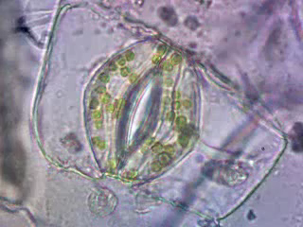
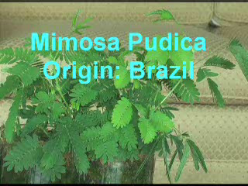
Cambios de turgencia celular
Δ Potencial hídrico
Δ Potencial osmótico entre células contiguas
Δ Potencial de membrana

Slide 2
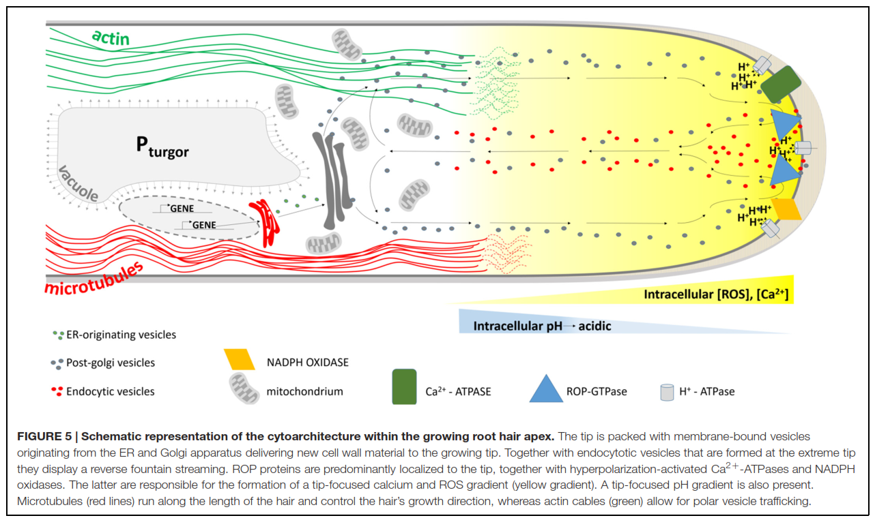
Acidificación de la pared
Incremento del Potencial osmótico vacuolar

Slide 3
Nutrient acquisition. Plants synthesize vital organic bio­ molecules from inorganic nutrients, many of which must be absorbed from the soil by roots for assimilation into amino acids and other metabolites
Metabolite distribution. In terrestrial plants, autotrophic tissues such as the photosynthetically active mesophyll cells in leaves supply reduced carbon and other metabo­lites to heterotrophic tissues
Compartmentalization of metabolites. Given the many metabolic pathways present within a plant cell, compart­ mentalization of enzymes and metabolites prevents futile cycling
Energy transduction. Membrane transport lies at the heart of biological energy conversion. Light energy drives electron transfer in chloroplasts and accumulation of protons (H ) in the thylakoid lumen. Similarly, oxidation of NADH provides energy for pumping H + from the mitochondrial matrix into the intermembrane space.
Waste product excretion. Metabolism inevitably generates waste products that must be removed from the cytosol.
Signal transduction. Many environmental and hormonal signals that influence plant growth and development are transduced via transiently increasing the concentration of cytosolic free Ca2+
Turgor generation. The presence of a rigid cell wall enables plant cells to generate turgor (positive hydrostatic
pres­sure). Turgor generation is accomplished by accumulating salts via specific membrane transporters
Compartmentalization and metabolic effi­ciency. In the mitochondrial matrix, for example, the
ADP/ATP and NADH/NAD ratios are greater than in the cytosol, which provides a substrate/product ratio
that favors respiratory activity. The corresponding trans­port mechanisms are required for mitochondrial export
of ATP and import of reducing equivalents

Slide 4
Nutrients are concentrated in the plant relative to the environment
[H₂PO₄⁻]_{o}
[HPO₄²⁻]_{o}
< 1 μM
[NO₃⁻]_{o}
<100 μM –
>1 mM
[NH₄⁺]_{o}
<100 μM –
>1 mM
Soil abundance (ranges or typical values)
[K+]_{o}
0.1 – 1 mM
Cell
[K+]_{i}
50 - 100 mM
[H₂PO₄⁻]_{i}
[HPO₄²⁻]_{i}
5 - 10 mM
[NO₃⁻]_{i}
10 mM
[NH₄⁺]_{i}
~1 mM
Energy is expended

Slide 5
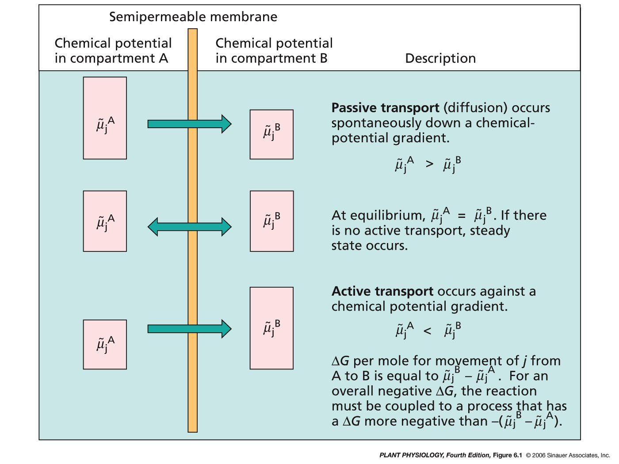

Notes:
pp4e-fig-06-01-0.jpg

Slide 6
Potencial de membrana
Qué es el Potencial de Membrana?
Cómo se origina el Potencial de Membrana?
Efecto Donnan
Bombas Electrogénicas

Slide 7
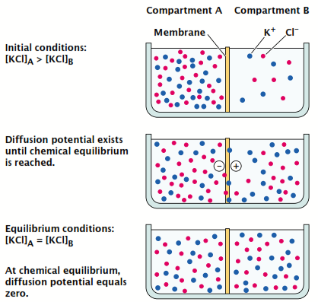
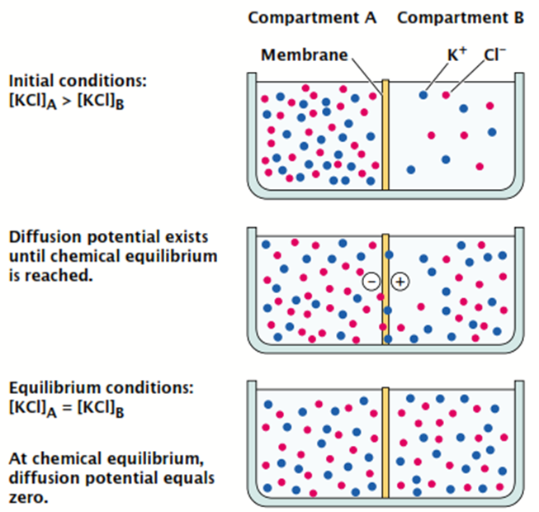
Membrana con:
t0
igual permeabilidad a cada ión
K⁺
Cl⁻
t5
t10
1) Hay un gradiente de concentración entre A y B?
Para los tres
tiempos
analizamos
2) Hay un gradiente eléctrico entre A y B?
3) Hay un potencial eléctrico entre A y B?
Notes:
pp4e-fig-06-02-0.jpg

Slide 8
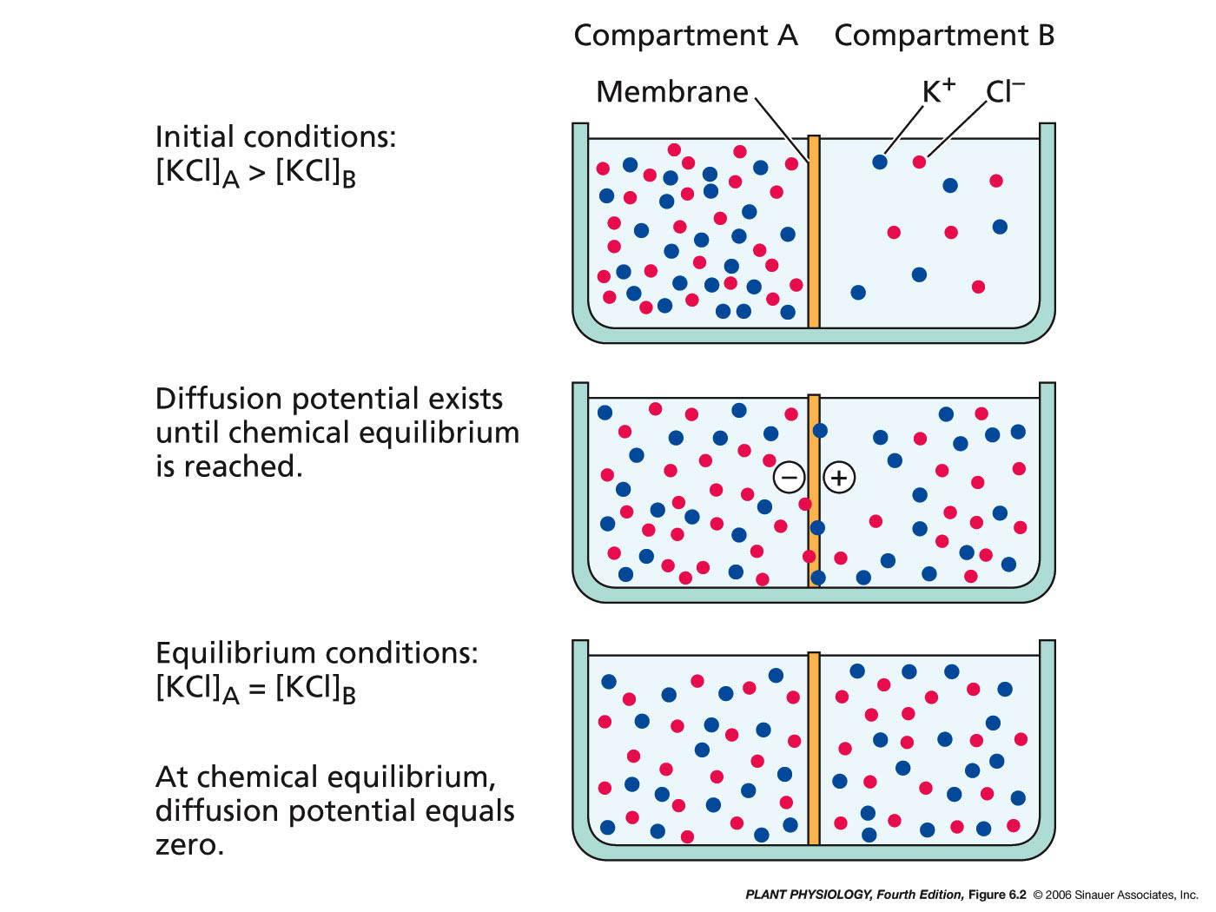
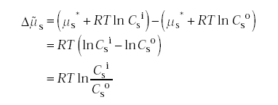

Slide 9

Pero que pasará si la membrana tiene permeabilidad selectiva?
Caso 1: distinta velocidad de difusión para cada ión.
Grad. Conc. Transit.
Polaridad transitoria

Slide 10
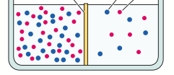
Caso 2 membrana con permeabilidad sel. por tamaño de poro
Equilibrio Donnan
= - 17 mV
T0
+
K⁺¹
Cl⁻¹
K⁺¹
Cl⁻¹
K⁺¹
Cl⁻¹
K⁺¹
Cl⁻¹
A
B
A
B

Slide 11



F is the Faraday constant = 96,500 C·mol
Delta de potencial electroquímico para el K

Slide 12
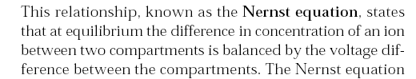

Un potencial de membrana igual a -120 mV permite que la
cantidad de K en el citoplasma pueda ser 100 veces superior
a la del apoplasto ( 150 mM vs 1 a 3 mM)

Slide 13
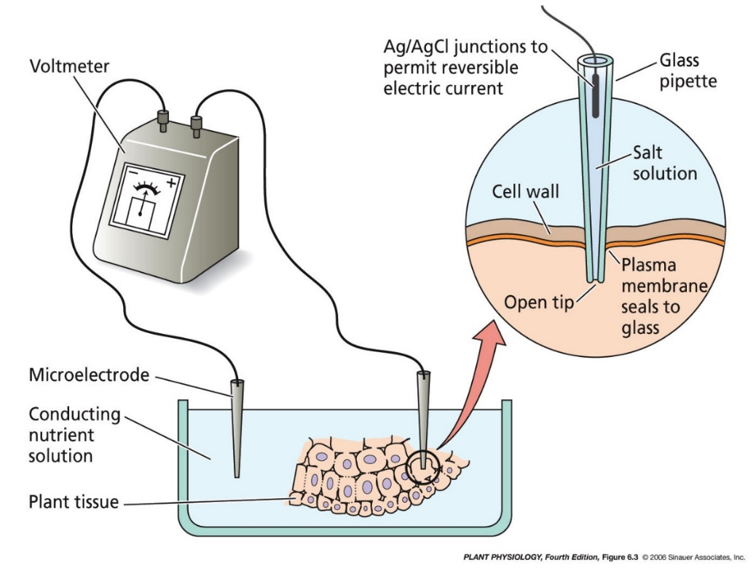

Cómo medimos el Potencial de Membrana?
Cuando lo medimos entre:
Citoplasma y pared celular
- 100 a -150 mV
Citoplasma y lumen vacuolar
- 90 mV
Equilibrio Donnan
- 17 mV
Notes:
pp4e-fig-06-03-0.jpg

Slide 14
The PM H⁺-ATPase is a “master enzyme” and “powerhouse”
By pumping protons out of the cell, PM H⁺-ATPases produce electric and pH gradients
+
pH ~ 5 - 6
+
+
+
+
ATP
-
-
-
-
-
pH ~ 7.5
H⁺
ADP
~ -150 mV
Antiporters
The electrochemical gradient produced by the PM H⁺-ATPase drives other transport processes
Channels
Symporters
Uniporters
Cations
Anions
H⁺
H⁺
See Palmgren, M.G. (2001). Plant plasma membrane H⁺-ATPases: Powerhouses for nutrient uptake. Annu. Rev. Plant Physiol. Plant Mol. Biol. 52: 817-845; Figure adapted from Michelet, B. and Boutry, M. (1995). The plasma membrane H⁺-ATPase. Plant Physiol. 108: 1-6.

Slide 15
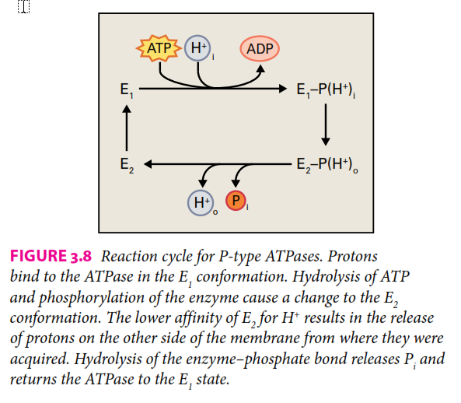
Plasma membrane H -ATPases constitute a family of proton pumps driven by hydrolysis of ATP and are found exclusively in the plasma membrane of plants
and fungi.
Plasma membrane H-ATPase forms a covalent enzyme-phosphate transition state during the reaction cycle ……………. P‐type family

Slide 16
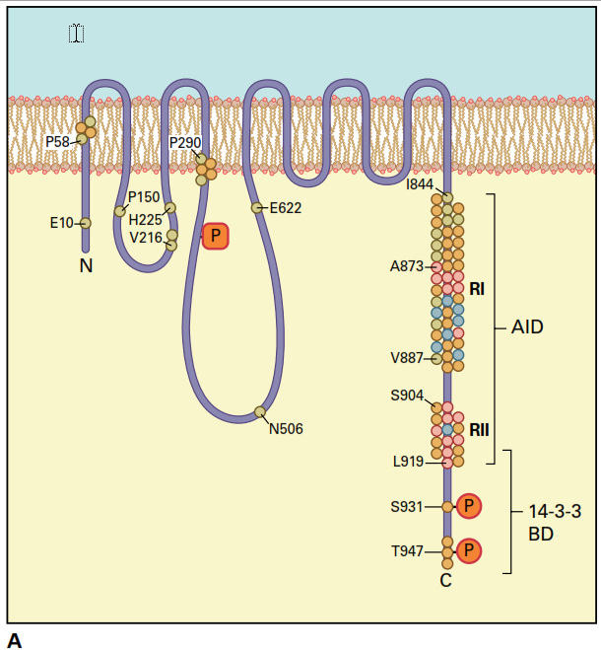
Most enzymes that play pivotal roles in metabolism are subject to intense regulation
The pump is activated in:
response to lowered cytosolic pH
blue light in guard cells

Slide 17
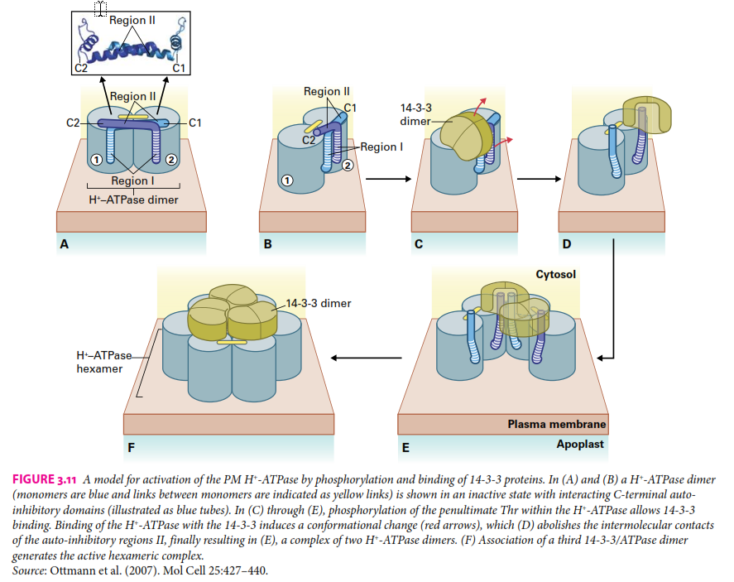
‐ATPase dimers (monomers are blue and links between monomers are indicated as yellow links) is shown in an inactive state with interacting C‐terminal auto‐inhibi-tory domains (illustrated as blue tubes).

Slide 18

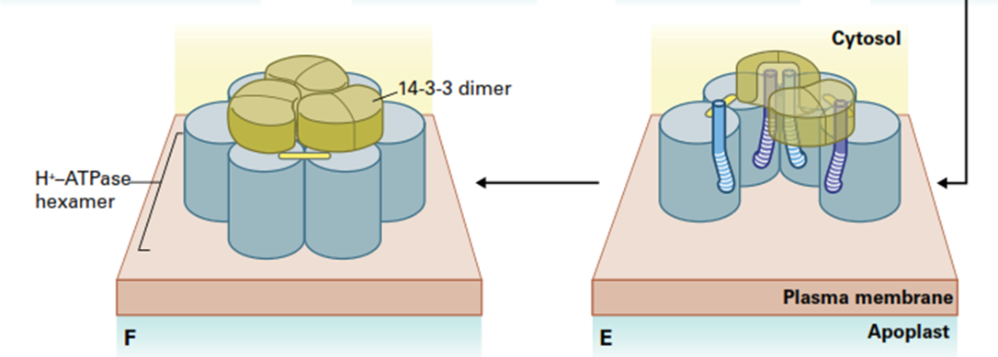
Binding of the H+‐ATPase with the 14‐3‐3 induces a conformational change (red arrows), which (D) abolishes the intermolecular contact of the auto‐inhibitory regions II.

Slide 19
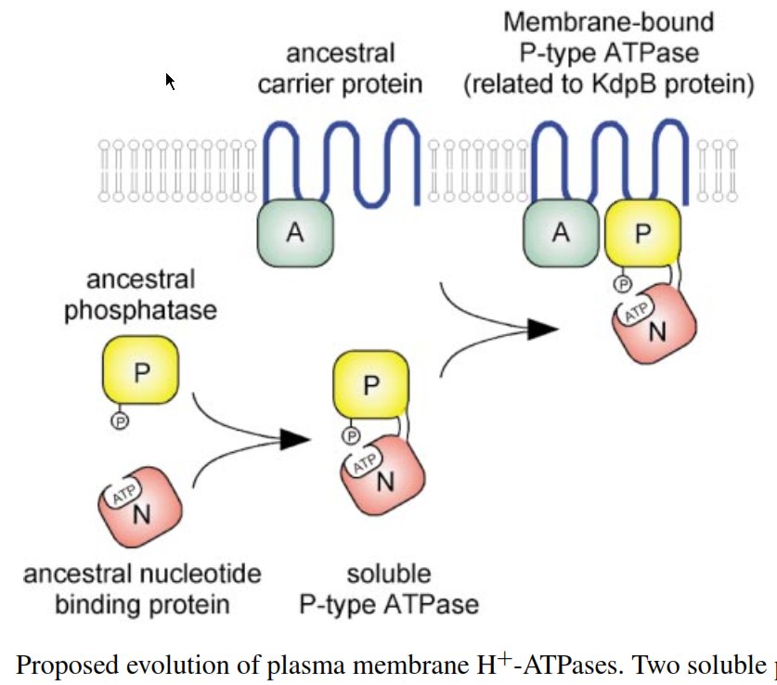
Annu. Rev. Plant Physiol. Plant Mol. Biol. 2001. 52:817–45

Slide 20
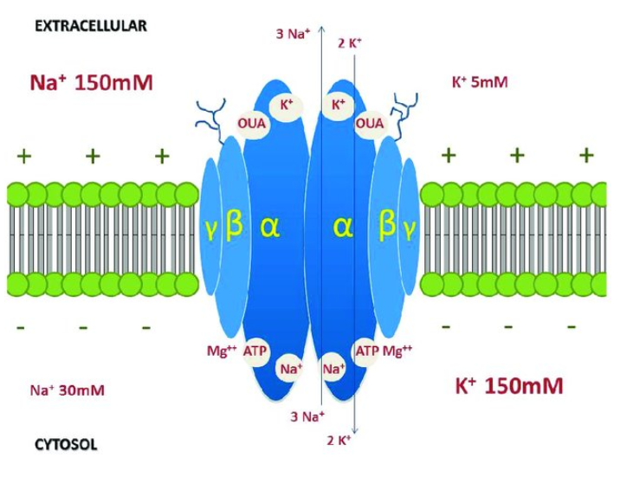
Other P type ATPases are:
the fungal plasma membrane H+-ATPases;
the animal Na+/K+-ATPase;
the gastric H+-ATPase;
the Ca2+-ATPases in the sarcoplasmic reticulum and in the plasma membrane, vacuolar membrane, and ER of plants, fungi, and animals;
heavy metal ATPases in bacteria and eukaryotes;
bacterial K+-ATPases

Slide 21
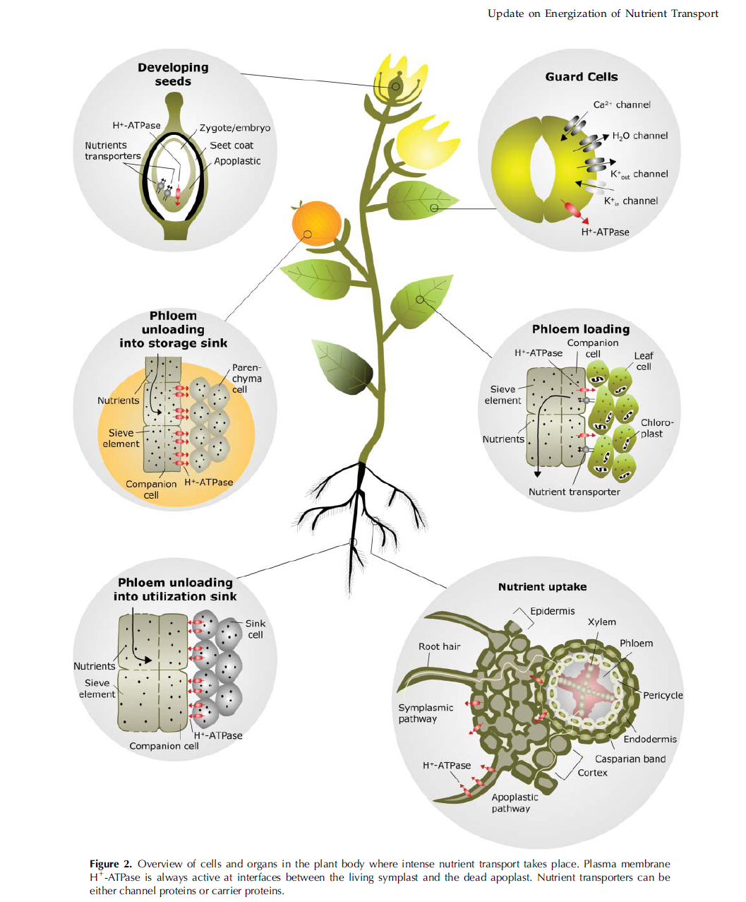
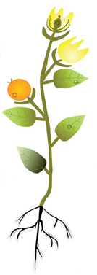
PM H⁺-ATPases have diverse physiological roles
Loss of function of the PM-H⁺-ATPase is lethal
PM H⁺-ATPases are required for
  nutrient assimilation and transport,
  cell growth, turgor and movement
  guard cell dynamics
Sondergaard, T.E., Schulz, A. and Palmgren, M.G. (2004). Energization of transport processes in plants. Roles of the plasma membrane H⁺-ATPase. Plant Physiol. 136: 2475-2482.

Slide 22
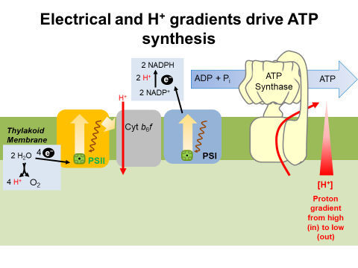
No confundir !!!!!
Pm H⁺ ATPasa
con ATP sintasa
Acumulación de protones

Slide 23
Most enzymes that play pivotal roles in metabolism are subject to intense regulation
Rubisco
PM H+ATPase
Nitrate Reductase
The pump is activated in:
response to lowered cytosolic pH
blue light in guard cells

Slide 24
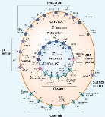
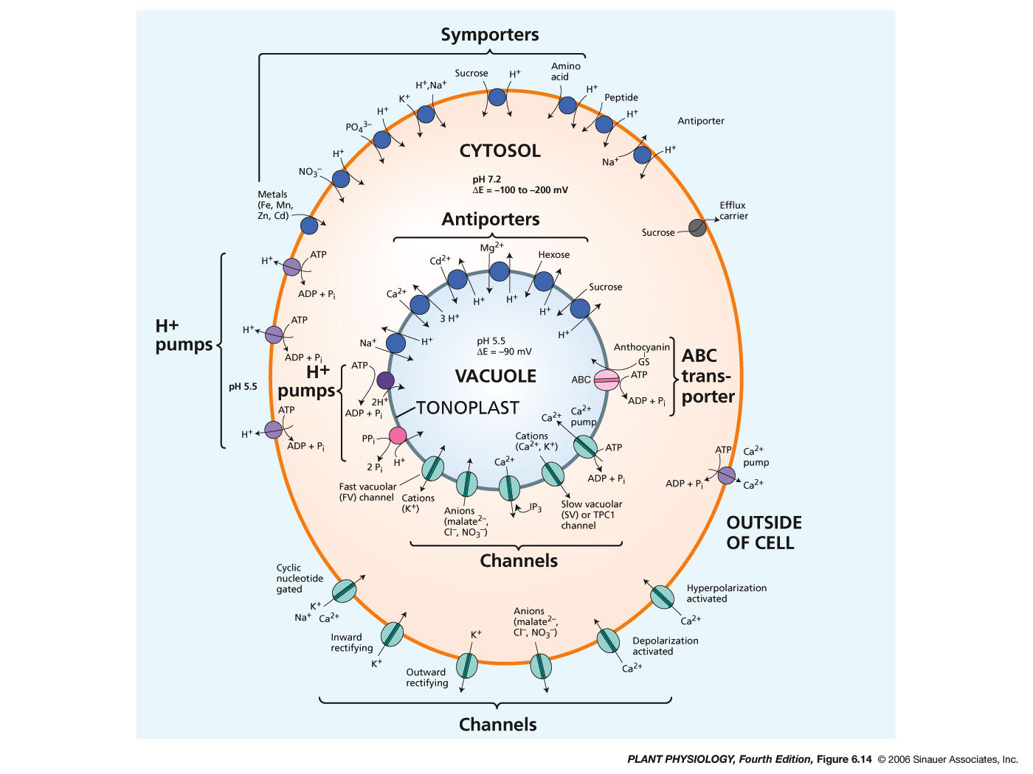
Bombas electrogénicas
Rate: 10² molecules s^{–1} transported
cytosolic pH is 7.5 and extracellular cell wall space pH is near 5.5.
100-fold proton gradient equates to a voltage of approximately –120 mV at 25°C.
Notes:
pp4e-fig-06-14-0.jpg

Slide 25
Vacuolar pumps pump protons into the vacuole and endocompartments
H⁺
pH 5 - 6
pH 7.5
H⁺
ATP
ADP + Pi
H⁺
PPi
2 x Pi
Protons are pumped into the vacuole by:
Vacuolar H⁺-ATPases (VH⁺-ATPases) and
Vacuolar pyrophosphatases (H⁺-PPases)
H⁺
H⁺
pH 3 - 6
E_{m} = ~ -30 mV
Sze, H., Li, X. and Palmgren, M.G. (1999). Energization of plant cell membranes by H⁺-pumping ATPases: Regulation and biosynthesis. Plant Cell. 11: 677-689. Isayenkov, S., Isner, J.C. and Maathuis, F.J.M. (2010). Vacuolar ion channels: Roles in plant nutrition and signalling. FEBS letters. 584: 1982-1988.

Slide 26
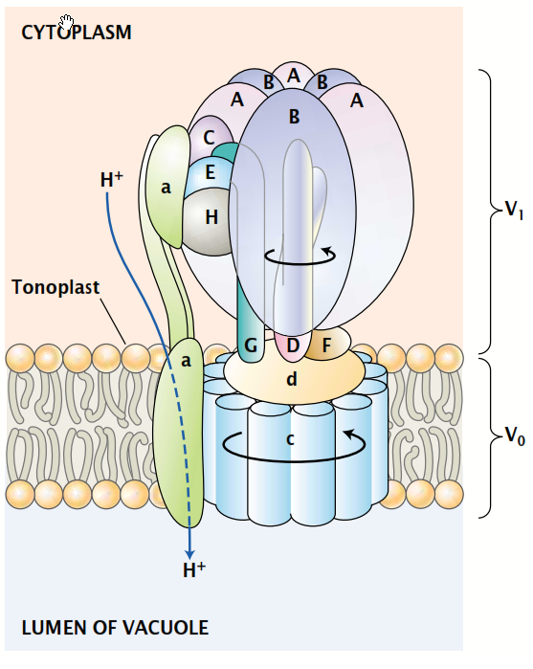
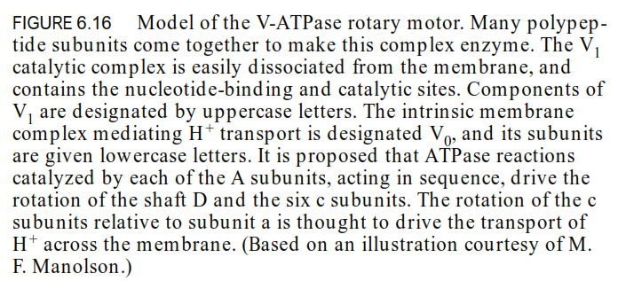
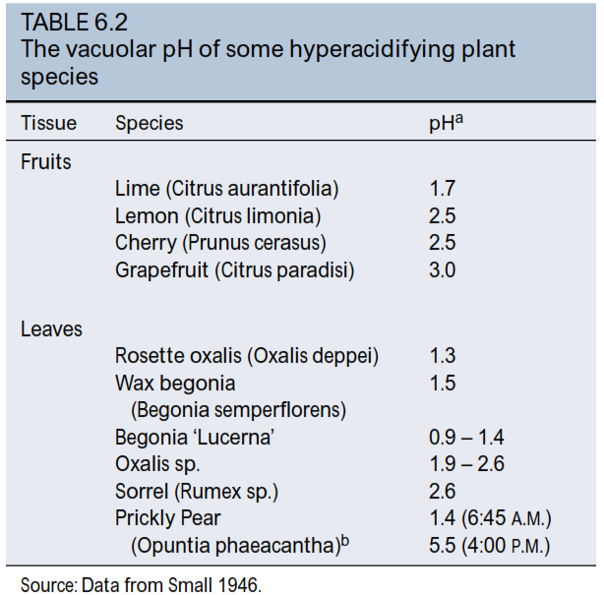

Slide 27
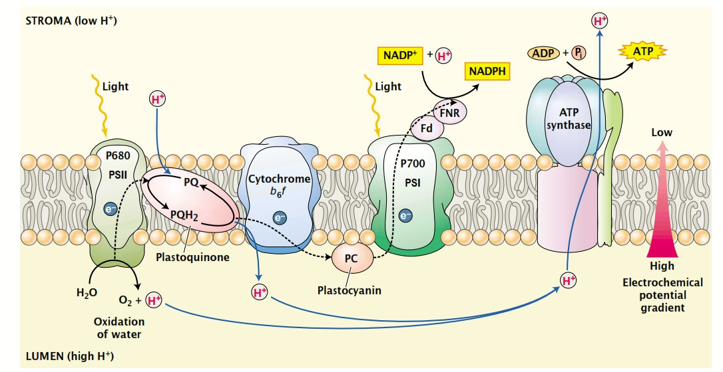

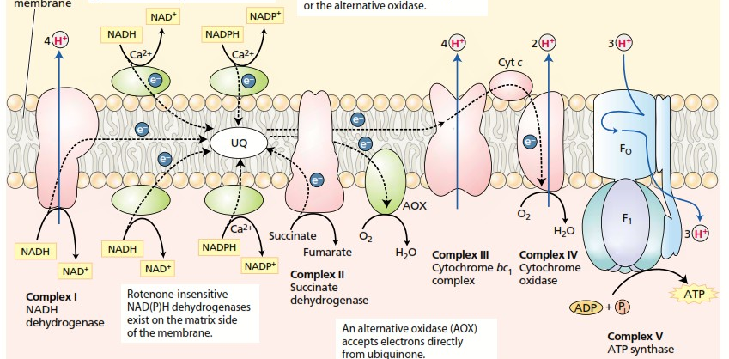
No confundir
jamás con
H⁺ ATPasa!

Slide 28
The F-type (ATP synthase) and the V-type (vacuolar or vesicular proton pump) ATPases,
have - distinct subcellular locations
- distinct roles
-marked similarities in subunit structure and mechanism.
They are both composed of a ‘soluble’ complex (termed F₁ or V₁) and a membrane complex (F_{o} or V_{o}). Within each ATPase complex, the two individual sectors appear to function as connected opposing rotary motors, coupling catalysis of ATP synthesis or hydrolysis to proton transport.
F-type (ATP synthase) vs V-type (H+-ATPasa)
Actividad
No electrogénica vs electrogénica
Estructura
polimérica
Ubicación
Cresta o tilacoide vs tonoplasto
Sustrato
ADP+Pi vs ATP + H+

Slide 29
P-type H+-ATPase vs V-type H+ ATPase
Actividad
electrogénicas
Estructura
monomérica vs polimérica
Ubicación
plasmamembrana vs tonoplasto
Sustrato
ATP
P-type H+-ATPase vs F-type ATPase
Actividad
Electrogénica vs no electrogénica
Estructura
monomérica vs polimérica
Ubicación
plasmamembrana vs tilacoides/cresta
Sustrato
ATP vs ADP + Pi

Slide 30
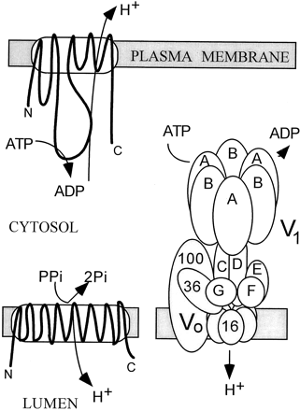
Energizing the membrane: Plant H⁺-ATPases and H⁺-PPases
The plasma-membrane H⁺-ATPase uses energy from ATP to pump protons out of the cell
The vacuolar-type proton pumps transport protons into the lumen of endomembrane compartments (e.g., vacuole)
The VH⁺-ATPase is a multimeric protein complex
The H⁺-PPase uses energy stored in pyrophosphate
Sze, H., Li, X. and Palmgren, M.G. (1999). Energization of plant cell membranes by H⁺-pumping ATPases: Regulation and biosynthesis. Plant Cell. 11: 677-689.

Slide 31
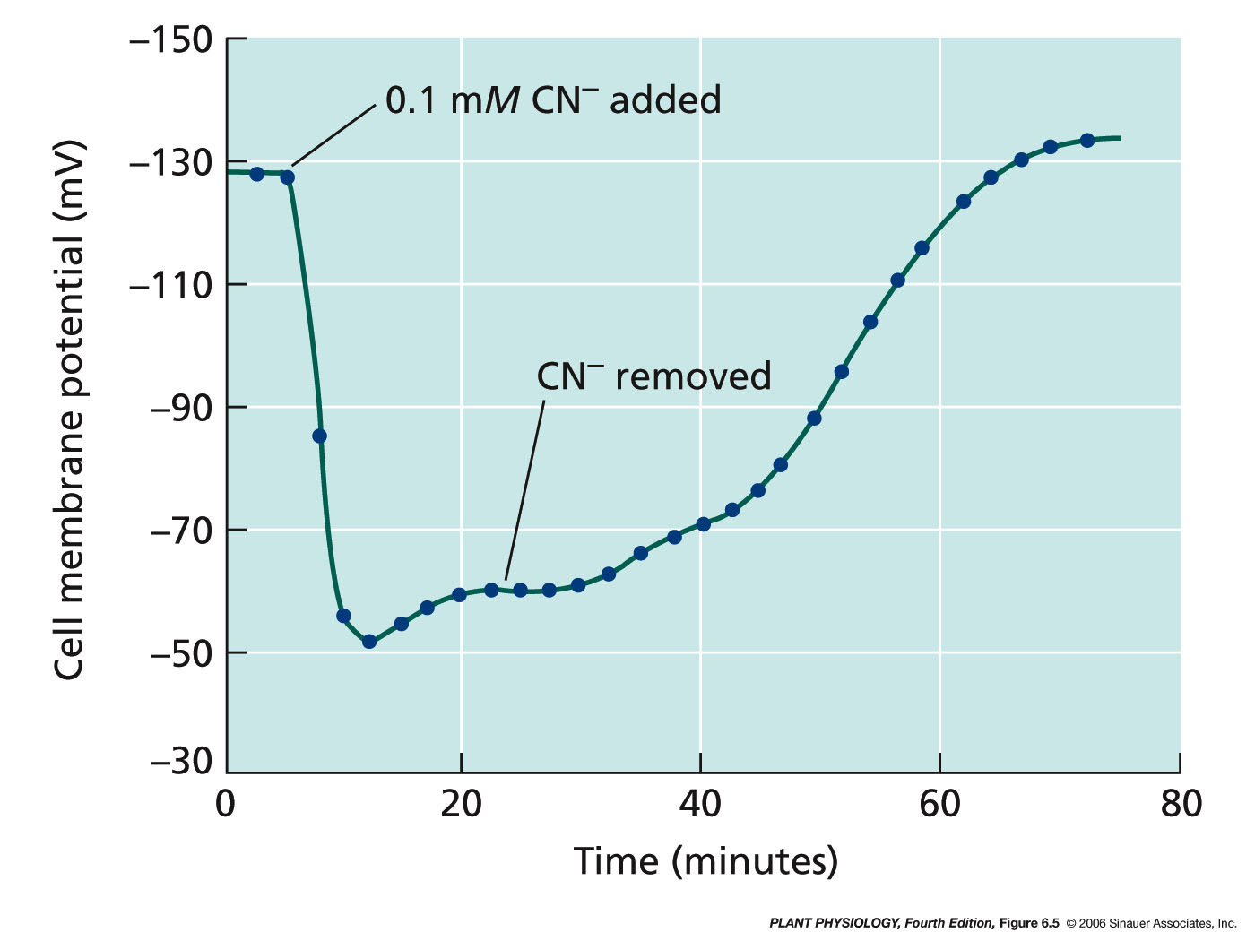
Material vegetal: trozo de raíz
Notes:
pp4e-fig-06-05-0.jpg

Slide 32
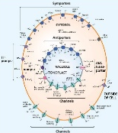
Bomba Ca²⁺-ATPasa
Notes:
pp4e-fig-06-14-0.jpg

Slide 33
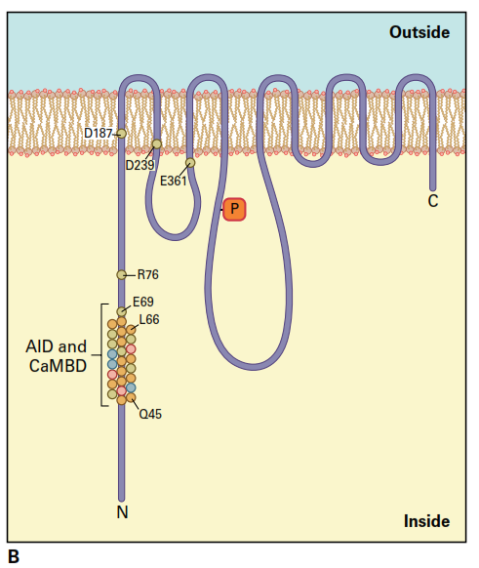
- Plasma membranes, - ER, - Tonoplast, - Inner plastid membrane, - Nuclear membrane, - Golgi apparatus.
Plant calcium pumps play an essential role in signal transduction path ways, they are responsible for the regulation of [Ca2+] in both cytoplasm and endomembrane compartments (0,2 μM).
These Ca2+ -ATPases appear to be involved in plant adaptation to stress conditions, like salinity, chilling or anoxia.

Slide 34
The electrochemical potential against which Ca²⁺ must be pumped by these enzymes is vast,
not only because the concentration of cytosolic free Ca²⁺
is several orders of magnitude less than that on the other side of the membrane,
but also because the negative membrane potential opposes the export of divalent cations with double the effective force imposed on monovalent cations.

Slide 35
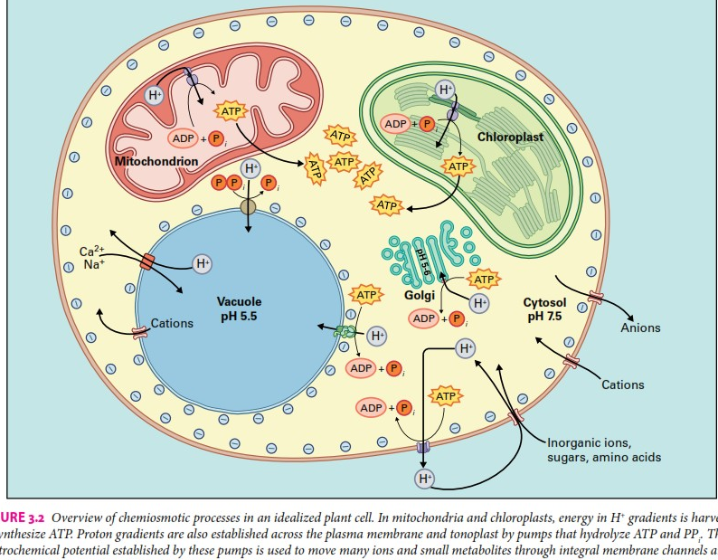
Overview

Slide 36
Bombas no electrogénicas
Notes:
pp4e-fig-06-14-0.jpg

Slide 37
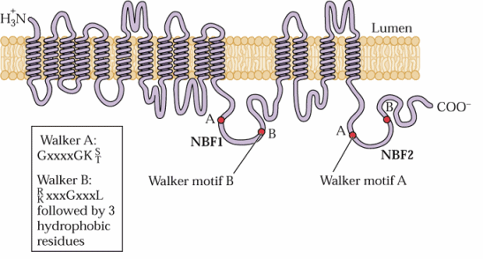
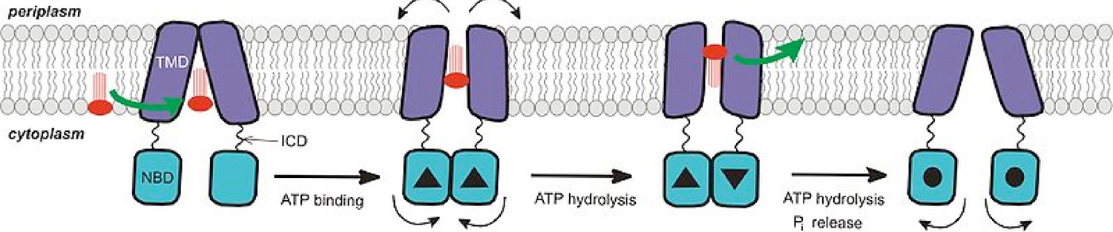
Transportadores ABC
Whole genome sequences indicate that plants possess well over a hundred ABC transporter genes, constituting the largest transporter gene family, suggesting roles as diverse as those described for other organisms
phosphate-binding loop
Walker,J.E.et al. 1982. EMBO J.v, 1 945–951

Slide 38
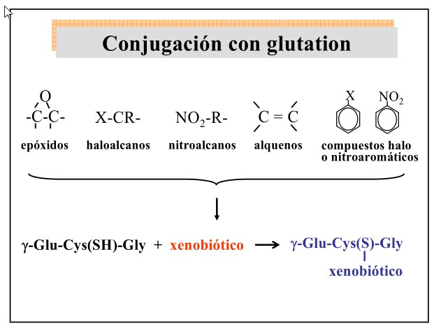

Slide 39
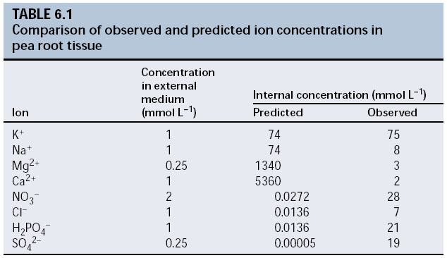

E_{i} = RT / (ziF) ln([i]_{in}/[i]_{out})
Notes:
pp4e-fig-06-06-0.jpg

Slide 40


Slide 41
Transport can be down or against an electrochemical gradient
Down an electrochemical gradient
(Diffusion or facilitated diffusion)
Against an electrochemical gradient
(Active transport)
Symport
Antiport
OUT
IN
Through membrane
Through channel
Through carrier
ATP
ADP + Pi
Secondary active transport: Indirectly coupled to ATP hydrolysis
Primary active transport: Directly coupled to ATP hydrolysis

Slide 42
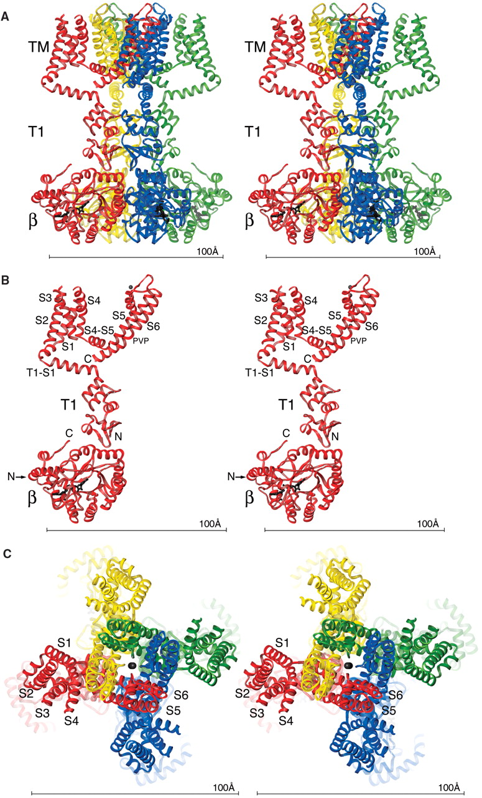
Solutes cross membranes through different types of transporters
Channels:
are protein-formed holes in the membrane
can be open or closed
move one type of solute at a time
do not provide an energy source for the movement; solutes can only move down their electrochemical gradient
X
X
X
Channels are often drawn as two adjacent ovals (or a cross-section of a doughnut)
Side (L) and Top (R) views of a potassium channel
Reprinted from Long, S.B., Campbell, E.B. and MacKinnon, R. (2005). Crystal structure of a mammalian voltage-dependent Shaker family K⁺ channel. Science. 309: 897-903 with permission from AAAS.

Slide 43
Canales de iones
Canales cambian de conformación y realizan ciclos entre conformación abierta y cerrada.
Cuando están abiertos permiten el paso continuo de muchos iones a traves de la membrana.
El control de apertura del canal es llevado a cabo en forma alostérica.
Pueden estar regulados por :
  Voltage
  Unión de un ligando (una molecula regulatoria, p.ej. cAMP, Ca, GTP)
  Estiramiento mecanico de la membrana (e.ej. Via citoesqueleto)

Slide 44
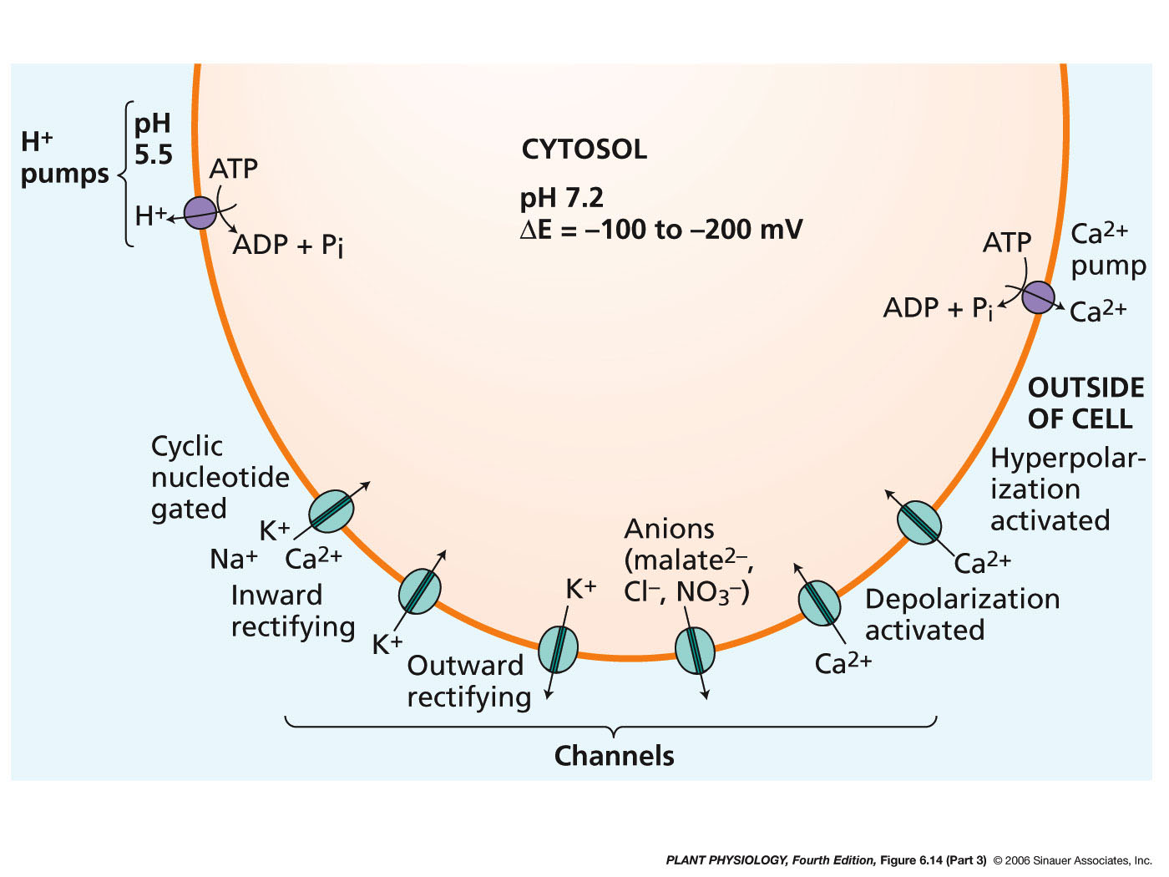
Notes:
pp4e-fig-06-14-3.jpg

Slide 45
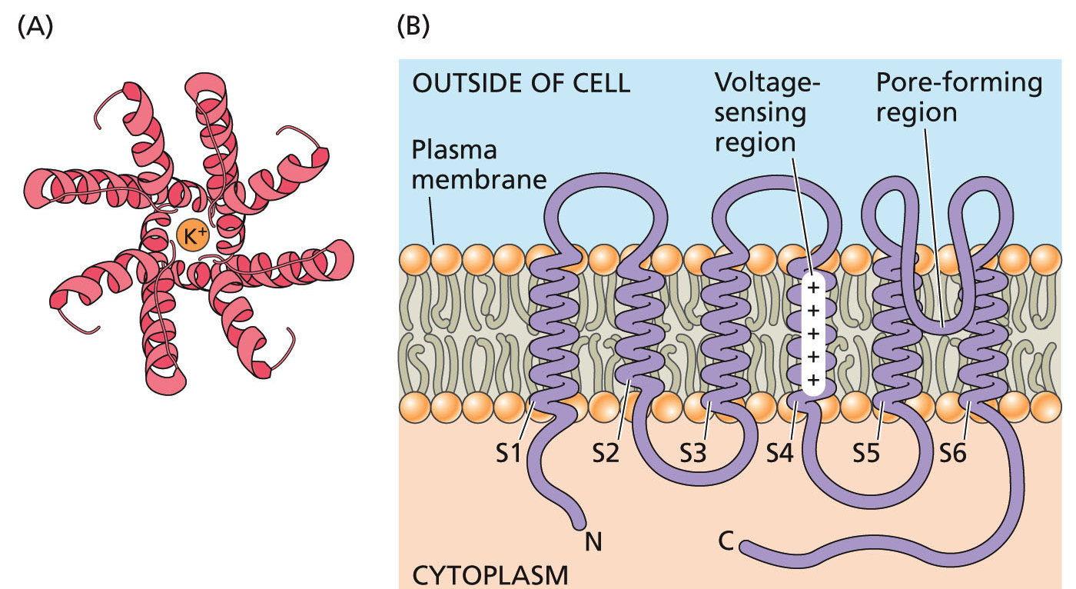
Canales cambian de conformación y realizan ciclos entre conformación abierta y cerrada.
El control de apertura del canal es llevado a cabo en forma alostérica.
Pueden estar regulados por :
  Voltage
  Unión de un ligando (una molecula regulatoria, p.ej. cAMP, Ca, GTP)
  Estiramiento mecanico de la membrana (e.ej. Via citoesqueleto)
Notes:
pp4e-fig-06-08-0.jpg

Slide 46
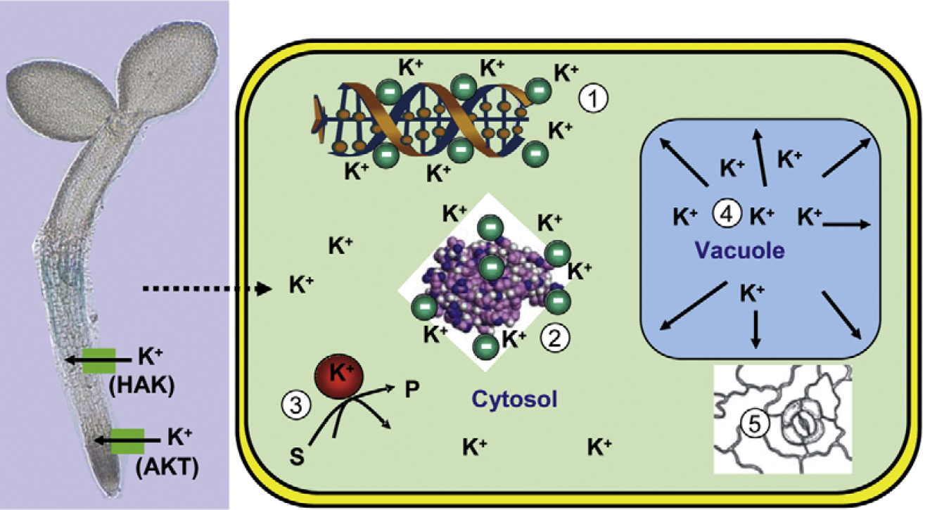
Potassium is an essential plant nutrient
K⁺ is a counter ion for negatively charged molecules including DNA and proteins
K⁺ moves in and out of the vacuole through specific transporters
As the major cation in the vacuole, K⁺ contributes to cell expansion and movement, including that of guard cells
K⁺ uptake involves high and low affinity transporters
K⁺ is a cofactor for some enzymes
Reprinted from Maathuis, F.J.M. (2009). Physiological functions of mineral macronutrients. Curr. Opin. Plant Biol. 12: 250-258 with permission from Elsevier.

Slide 47
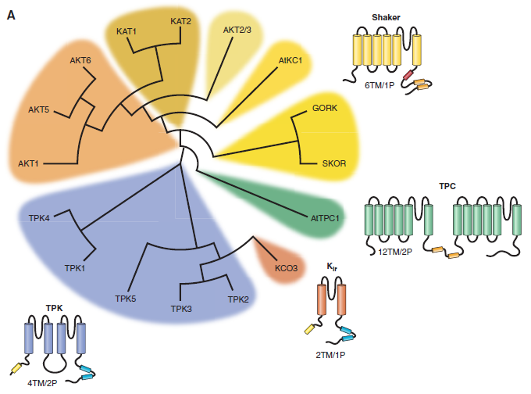
There are 15 genes encoding potassium channels in Arabidopsis
9 Shaker-type (Kv)
(Plasma membrane)
1 Non-selective two-pore cation (TPC) channel
5 Two Pore K⁺ (TPK) channels
(mostly tonoplast)
1 K_{ir}-like potassium channel
Used with permission from Hedrich, R. (2012). Ion channels in plants. Physiol.Rev. 92: 1777-1811.

Slide 48
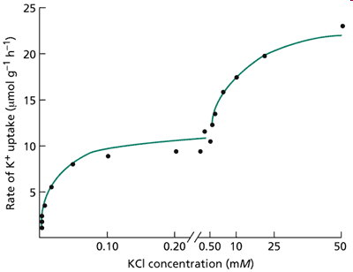
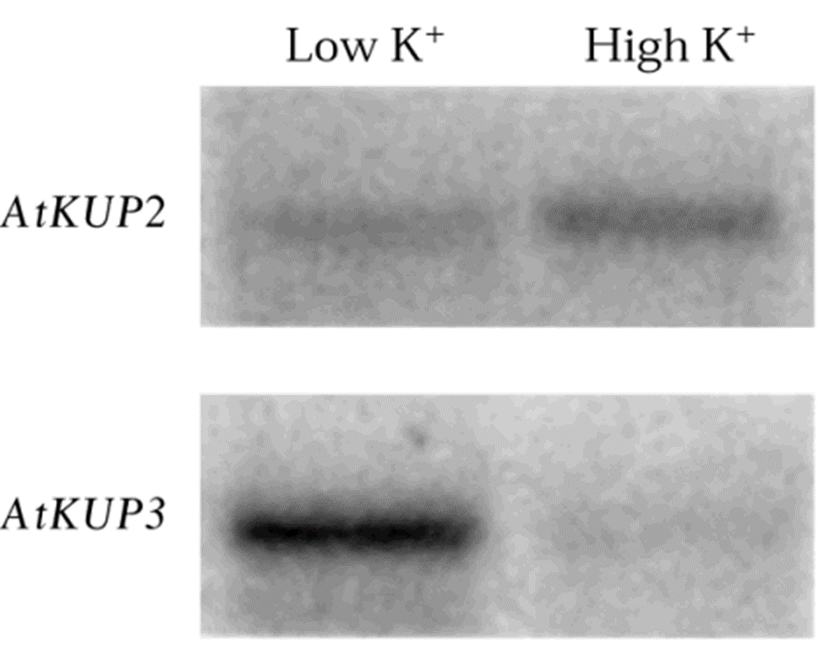
Algunas particularidades de los canales de K

Slide 49
Guard cells are model systems for the study of K⁺ transport
OPEN
CLOSING
V-ATPase
H⁺
H⁺
The depth and breadth of information available for stomatal guard cells has made them the premier cell system in plants for studies of membrane transport, signaling, and homeostasis
V-PPase
A⁻
H⁺
H⁺
A⁻
H⁺
TPK
K⁺
H⁺
K⁺
K⁺
TPC
PM-H⁺-ATPase
GORK
KAT
K⁺
Hills, A., Chen, Z.-H., Amtmann, A., Blatt, M.R. and Lew, V.L. (2012). OnGuard, a computational platform for quantitative kinetic modeling of guard cell physiology. Plant Physiol. 159: 1026-1042 Chen, Z.-H., Hills, A., Bätz, U., Amtmann, A., Lew, V.L. and Blatt, M.R. (2012). Systems dynamic modeling of the stomatal guard cell predicts emergent behaviors in transport, signaling, and volume control. Plant Physiology. 159: 1235-1251.

Slide 50
?

Slide 51
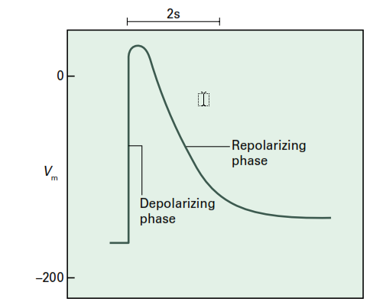
K⁺ en el citoplasma puede llegar a estar 150 mM mientras que en apoplasto 1,5 mM…..
?
Hiperpolarizacion
Despolarización
– 150mV
Cómo se despolariza la MP?
Ralentizar actividad ⁺H-ATPasa
K⁺ int > 150 mM
Abrir canales anionicos: Cl⁻, Malato

Slide 54
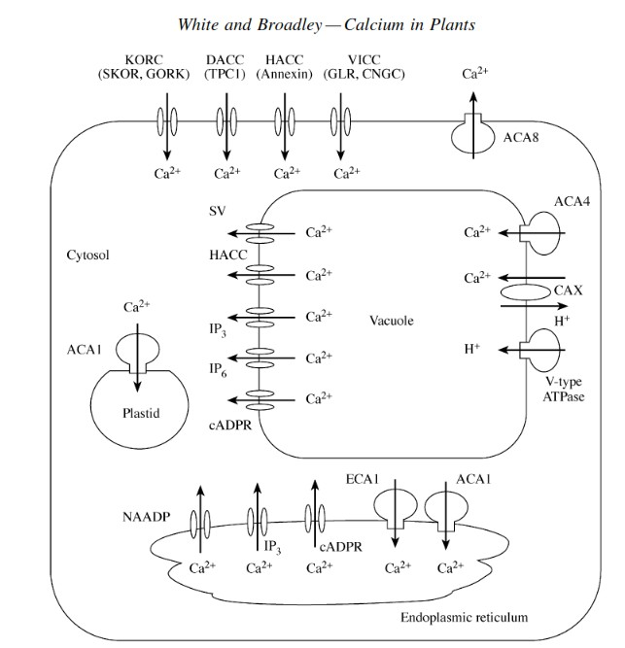
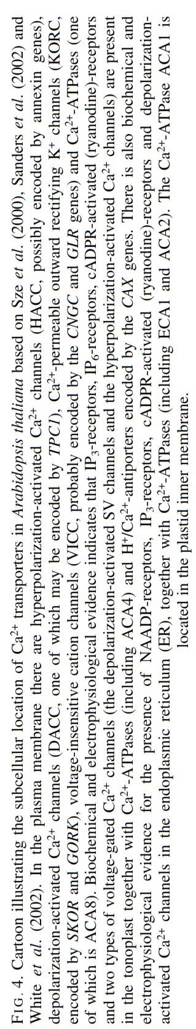


Slide 55
Transporte activo secundario
Notes:
pp4e-fig-06-07-0.jpg

Slide 56
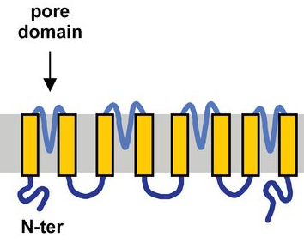
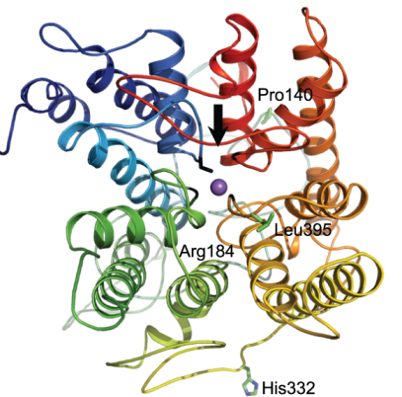
Solutes cross membranes through different types of transporters
Carriers /
Coupled Transporters
are membrane proteins
can be active or inactive
can move more than one solute at a time
The driver (usually H⁺ in plants) moves down its electrochemical gradient, which provides the energy for the co-transported solute’s transport
H⁺
X
H⁺
H⁺
X
X
Coupled transporters are often drawn as circles with arrows indicating the direction of flow for each ion
Schematic domain structure (L) and Top-down (R) views of an HKT1 Na⁺ transporter
Cotsaftis, O., Plett, D., Shirley, N., Tester, M. and Hrmova, M. (2012). A two-staged model of Na⁺ exclusion in rice explained by 3D modeling of HKT transporters and alternative splicing. PLoS ONE. 7: e39865. Chérel, I., Lefoulon, C., Boeglin, M. and Sentenac, H. (2014). Molecular mechanisms involved in plant adaptation to low K⁺ availability. J. Exp. Bot. 65: 833-848, by permission of Oxford University Press.

Slide 57
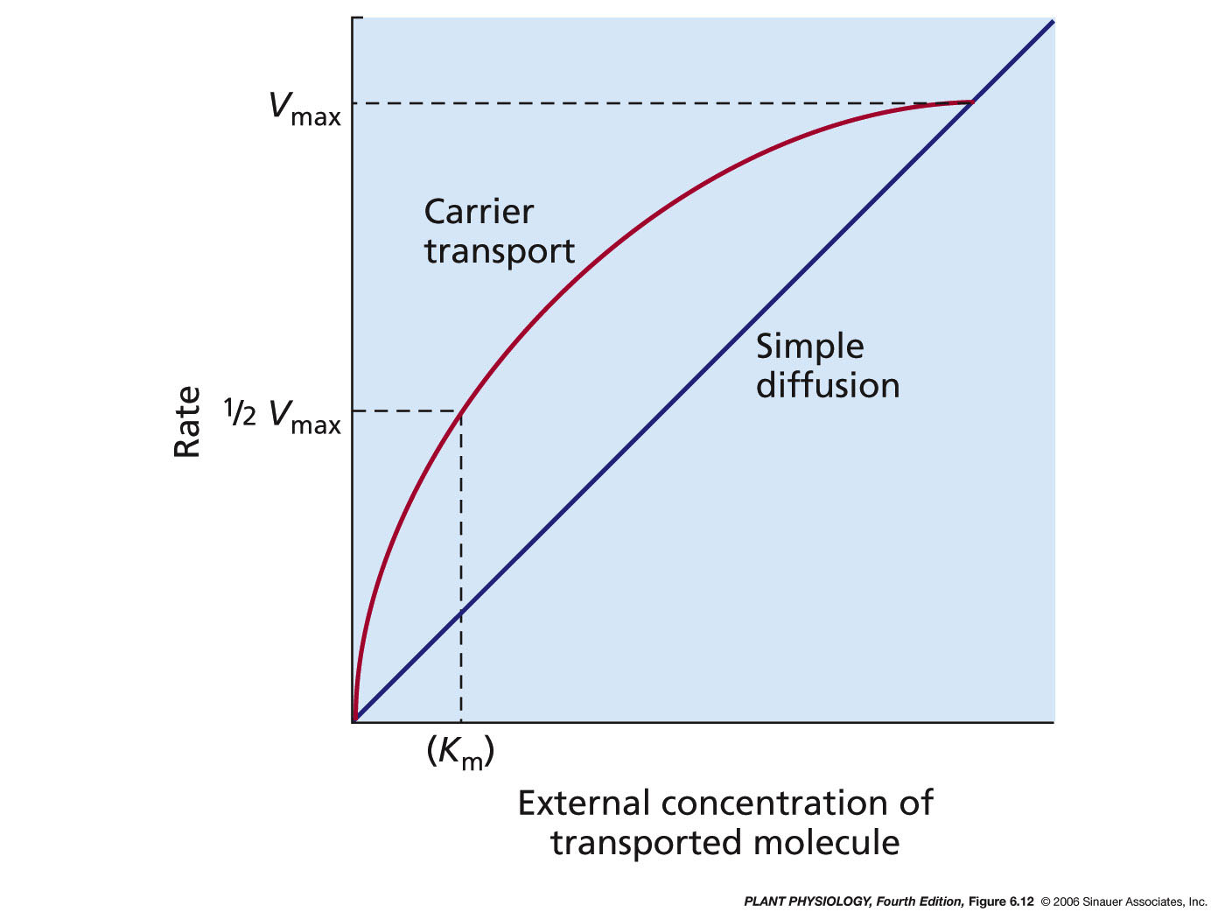
Las proteinas carrier realizan un ciclo de conformaciones en el que el sitio de unión del soluto está accesible de un lado de la membrana o del otro.
No existe un canal abierto, sino que una o un numero limitado de moleculas se une al carrier por cada ciclo de conformaciones.
Los carries muestran cinéticas de Michaelis-Menten
Notes:
pp4e-fig-06-12-0.jpg

Slide 58
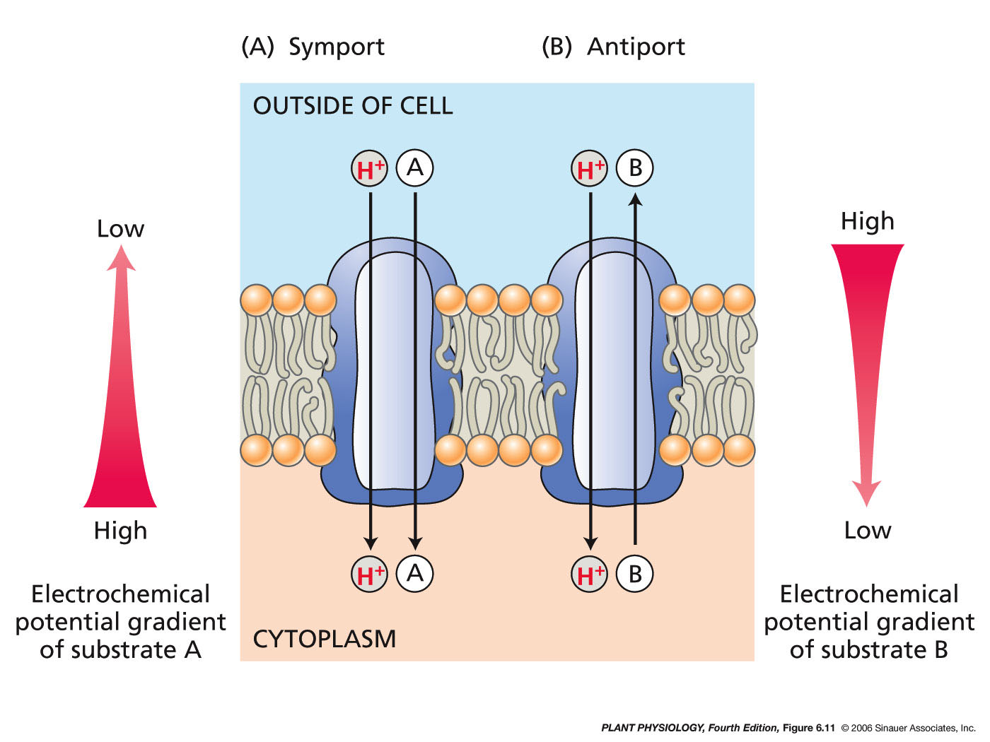
Tipos de carriers
10
3
–10
6
s
.
–1
Notes:
pp4e-fig-06-11-0.jpg

Slide 59




Transporte activo secundario
Notes:
pp4e-fig-06-10-1.jpg

Slide 60
Notes:
pp4e-fig-06-14-0.jpg

Slide 61

Detalle de la vacuola
Para discutir con el
compañero durante el
estudio.
Explicar la línea llena o
cortada para cada ión.
Linea punteada = a favor de gradiente
Linea llena = contragradieente

Slide 62

Transceptores de nitratos en pelos radicales

Slide 63


Slide 64



Slide 65


Slide 66

Distribución asimétrica de transportadores en la endodermis
Julien Alassimone,Sadaf Naseer,Niko Geldner
PNAS March 16, 2010. 107 (11) 5214-5219; https://doi.org/10.1073/pnas.0910772107

Slide 67



Slide 68
Adquicisión de nutrientes (minerales, pero tambien orgánicos)
Excreción de productos de desecho (p.ej. ABC-transporters)
Distribución de metabolitos (a nivel órganos)
Compartimentalización de metabolitos (a nivel celular)
Transducción de energía (p.ej. Pumps)
Generación de Turgor (azúcares, iones)
Transducción de señales (p.ej. Ca)
Funciones generales de los transportadores

Slide 69
Transport activity is a function of: transporter rate and the number of transporters in the membrane.
Pumps
10² molec. s^{–1}
large conformational
transitions to couple metabolic reactions to transport
Transporte activo
primario
also undergo conformational changes
but transport rates are greater than those
of pumps
Cotransporters
10³–10⁶ molec. s^{–1}
Transporte activo
secundario
Channels
10⁶-10⁷ molec. s-1
do not undergo
conformational changes during transport
Transporte pasivo

Slide 70
Tasa de transporte diferencial entre bombas, carriers y canales
llevaría a un desequilibrio iónico en la célula…..
Transport activity is also a function of: number of transporters in the membrane.
A square micrometer of mem­brane may include
several hundred to several thousand pump proteins,
but typically contains only 1–10 channel proteins.

Slide 71


Pumps, channels and carriers are also involved in nutrient distribution
Reprinted from Ahmad, I. and Maathuis, F.J.M. (2014). Cellular and tissue distribution of potassium: Physiological relevance, mechanisms and regulation. J. Plant Physiol. 171: 708–714 with permission from Elsevier.

Slide 72


Slide 73

Otros transportadores de la membrana interna de cloroplasto

Slide 74

Translocador Fosfoenolpiruvato- ortofosfato en plantas C4

Slide 75

Translocador Fosfoenolpiruvato- ortofosfato en plantas C3

Slide 76

El gradientes electroquímico también sustenta el transporte de ATP/ADP, Pi, malato, piruvato

Slide 77



?
Que sustancia se agregó al medio?
T₀
Tengan en cuenta que la sustancia agregada no es removida del medio como era el caso en el anterior desafío

